Slide 1
Please sign the sign-in sheet up front each day!

Slide 2

Machine Learning and Deep Learning Fundamentals with Python
John Sukup - Instructor

Slide 3

Instructor Introduction
12 Years in research and data analytics with The Nielsen Company, BlueCross BlueShield, and others
Model development for Department of Energy’s SPR and Telemedicine Impact Score projects
Business experience across several industries including healthcare, CPG, energy, financial services, insurance, consumer tech, and manufacturing
Expertise in data modeling, Big Data solutions consulting, Python, R, Microsoft Cognitive Services, etc.
MS/BS Purdue University and several professional certifications

Slide 4
Classroom Setup

Slide 5
Before we get started…
Course is 2 days – Please show up on time or you will be counted absent!
One hour lunch break
Two 15 minute breaks
Feel free to leave for important phone calls or bathroom emergencies!
Silence phones
Bring laptops for labs
Labs are administered in Google Colaboratory with Jupyter Notebooks
You will need a Google account AND Chrome to run labs
No software or virtual machine downloads required!

Slide 6
Introduction to Machine Learning (ML) and Deep Learning (DL)

Slide 7
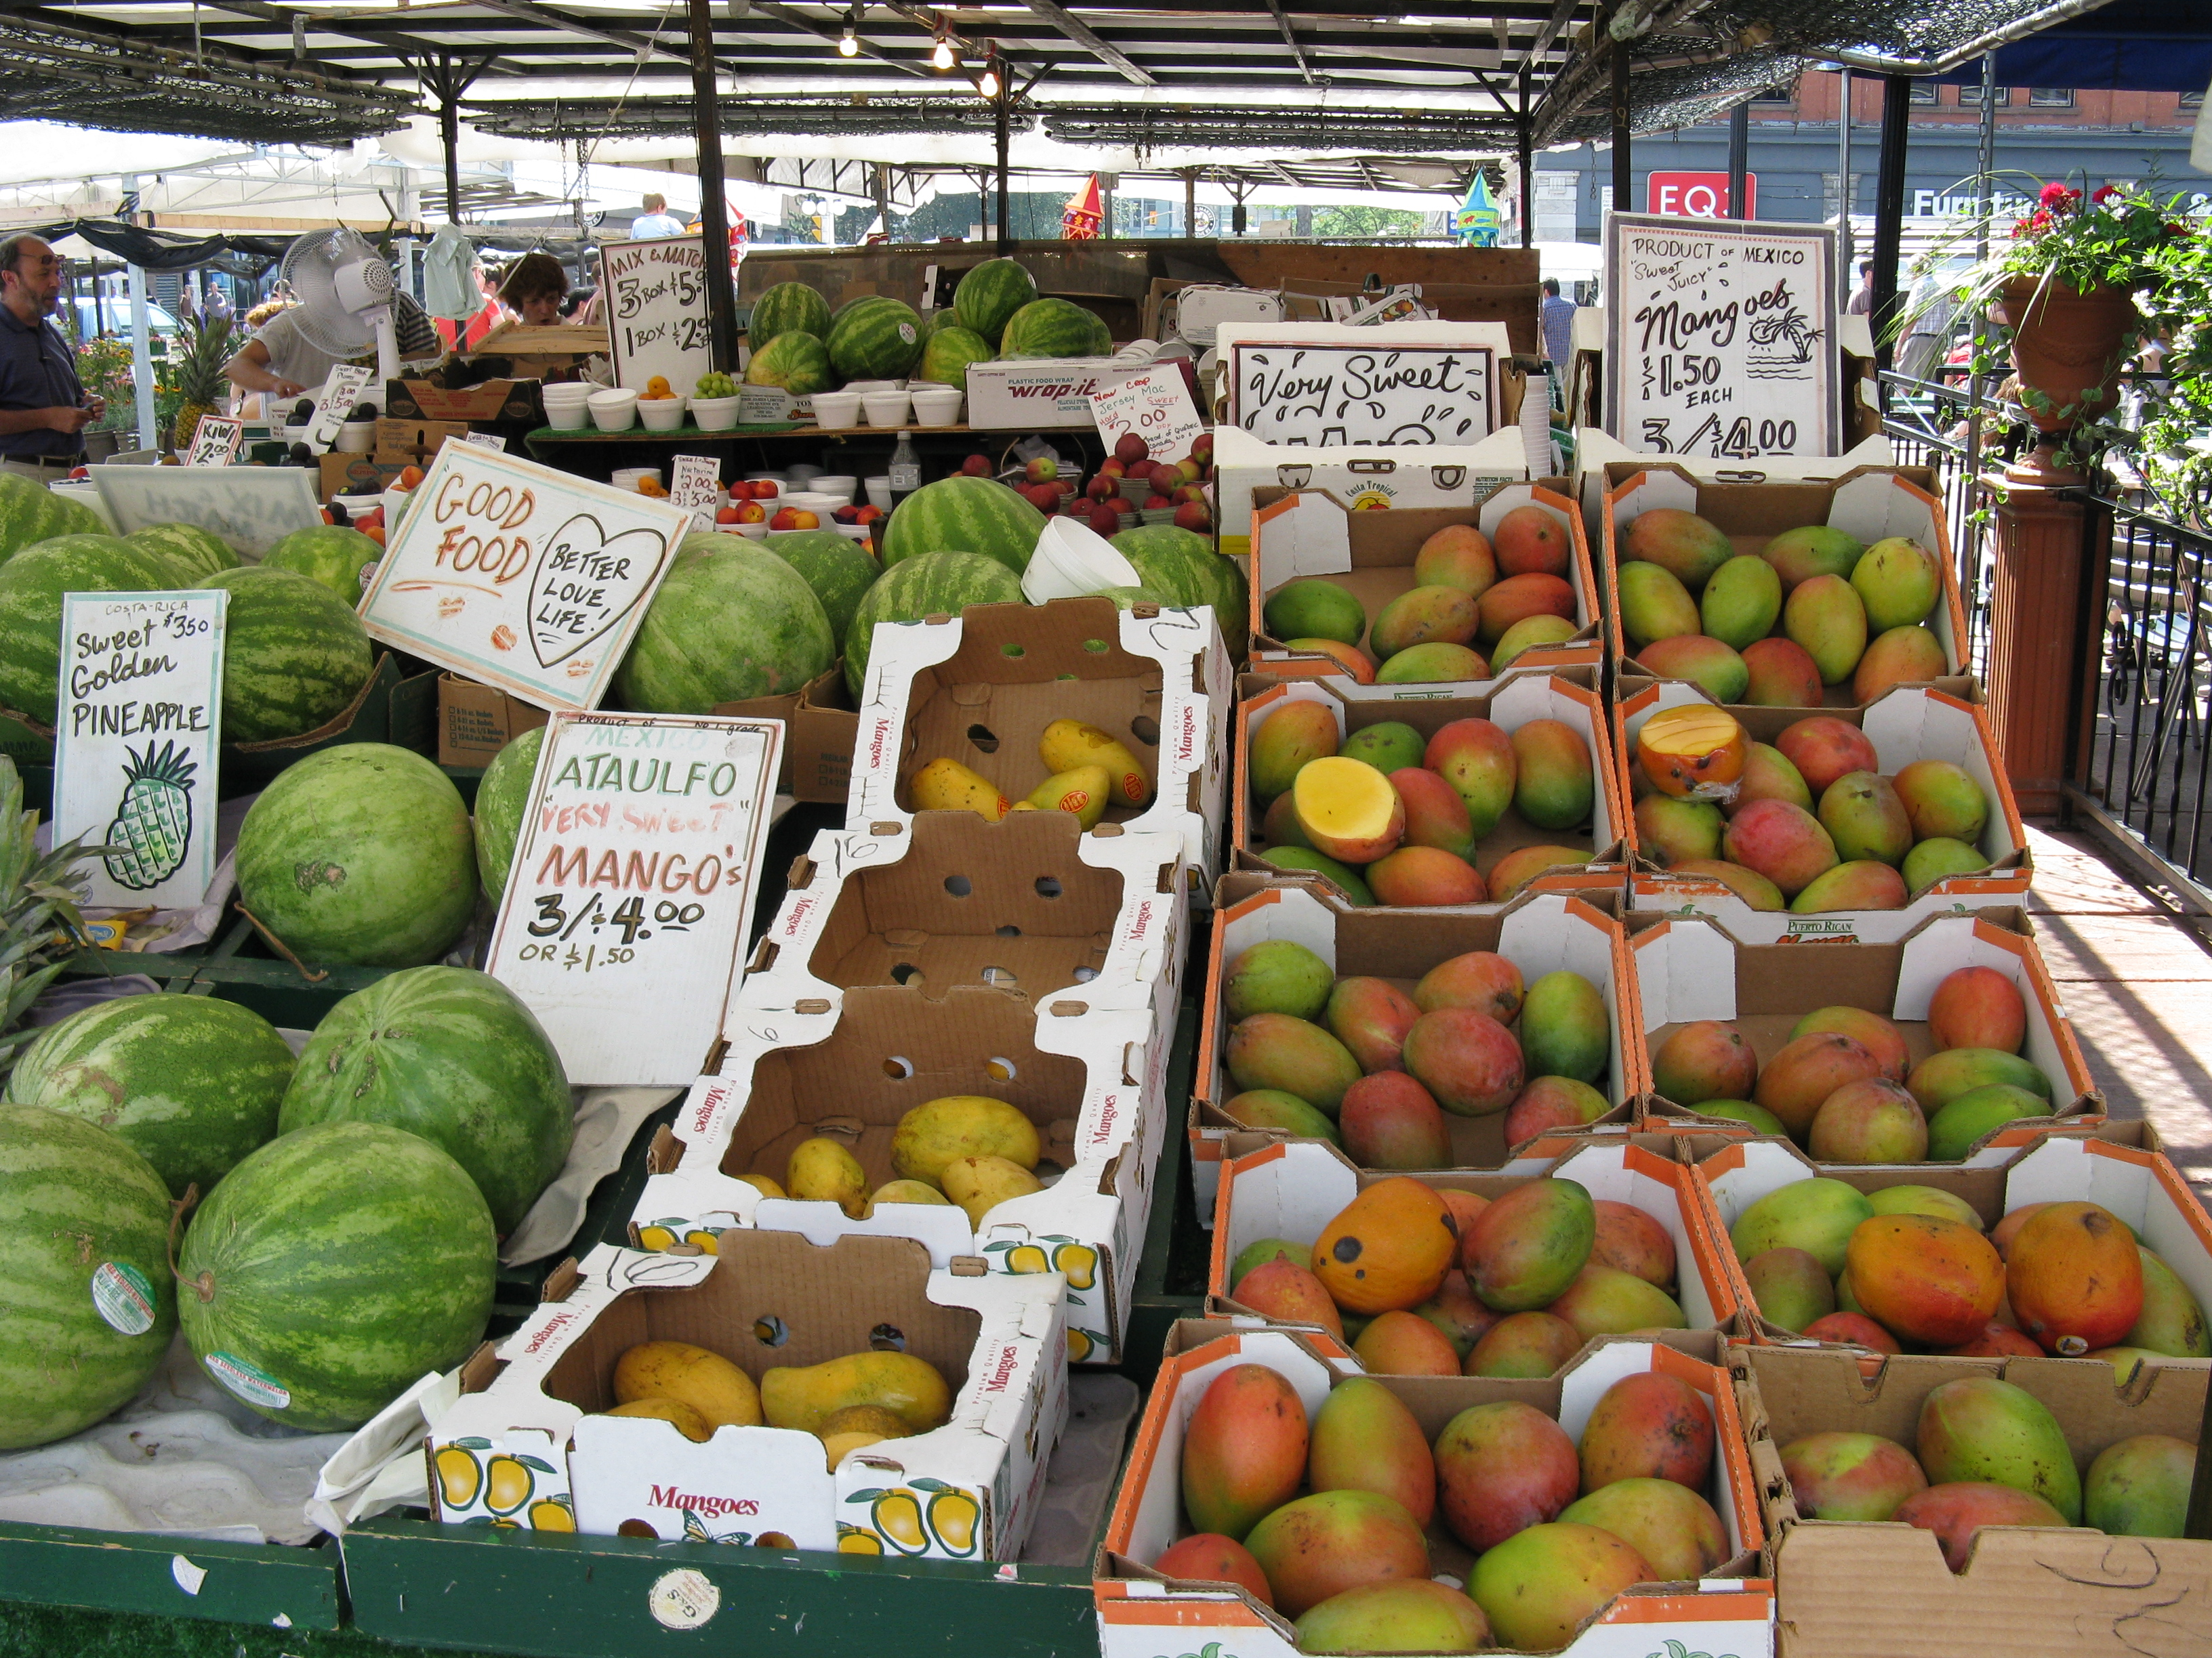
What is Machine Learning/Deep Learning?
Source: https://en.wikipedia.org/wiki/Fruit_stand#/media/File:Byward_Market_Fruit_Stand.jpg

Slide 8
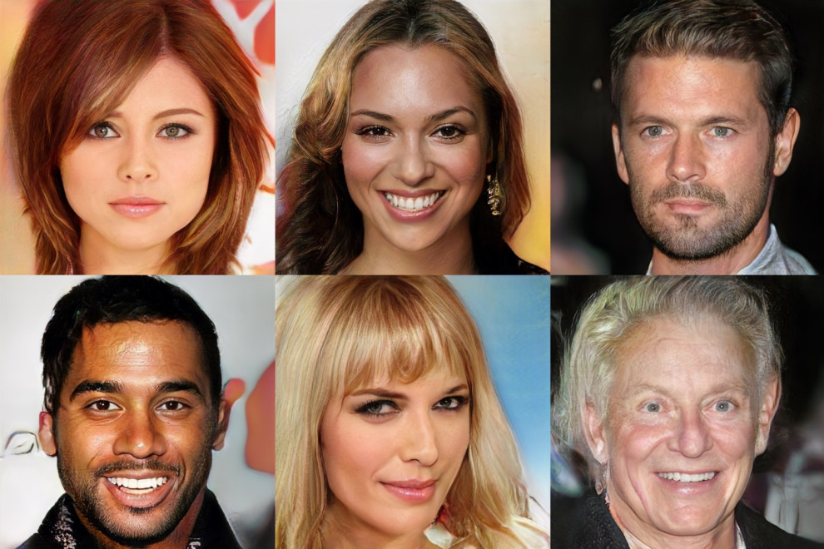
What is Machine Learning/Deep Learning?
Source: https://techcrunch.com/2017/10/31/i-feel-like-i-know-these-computer-generated-celebrities-already/

Slide 9

Source: https://www.youtube.com/watch?v=36lE9tV9vm0

Slide 10

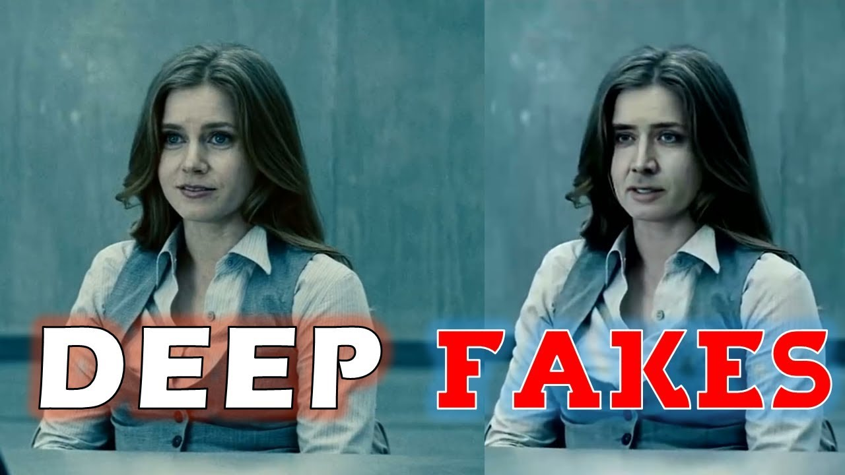
What is Machine Learning/Deep Learning?
Source: https://i.ytimg.com/vi/2sFK82Cvm4I/maxresdefault.jpg/;
http://www.slashfilm.com/wp/wp-content/images/nicolascage-faceoff-crazy.jpg

Slide 11
Source: https://youtu.be/iHv6Q9ychnA

Slide 12
What will I learn?
What Machine Learning (ML) and Deep Learning (DL) practitioners spend most of their time on
How to build a business case for utilizing ML/DL
Conceptual understanding of how some basic ML/DL algorithms work
Applications of ML/DL in Python and other tools in the tool chest
How to test, “tune,” and scrutinize the efficacy of ML/DL models
How ML/DL is being used in the world today

Slide 13
Statistics, Probability, and Machine Learning

Slide 14
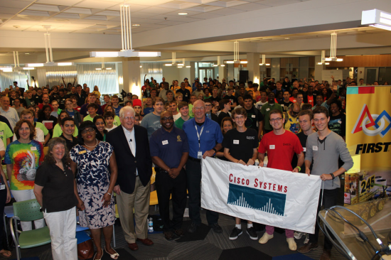

POPULATION
sample
Source: https://alln-extcloud-storage.cisco.com/ciscoblogs/FTC_1-550x366.png;
http://www.jobbertechtalk.com/wp-content/uploads/2015/04/Diversity-small.jpg

Slide 15
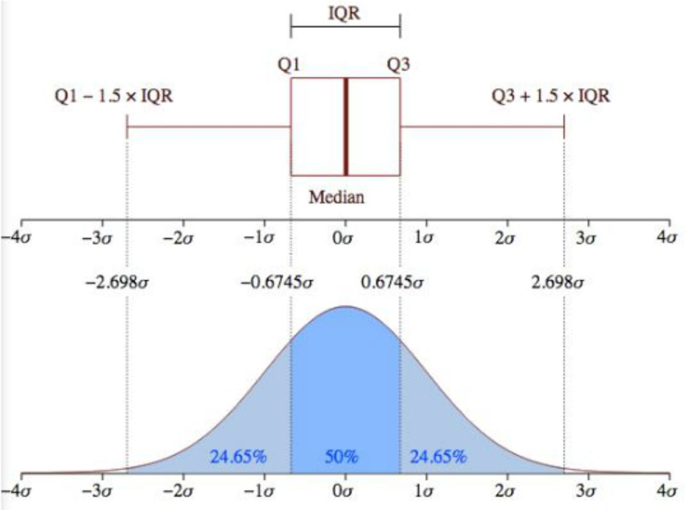
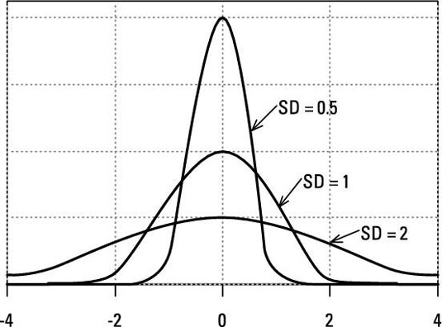
Key Terms - Statistics
Measures of Central Tendency
Mean, Median, Mode
Measures of Dispersion
Variance/Standard Deviation
Range/Inter-quartile Range
Data Types
Quantitative/Qualitative
Continuous/Discrete
Source: http://cfile22.uf.tistory.com/image/2744E743585C560E17B141;
http://projectmanager.com.au/wp-content/uploads/2016/07/Weaver_SD1.jpg

Slide 16
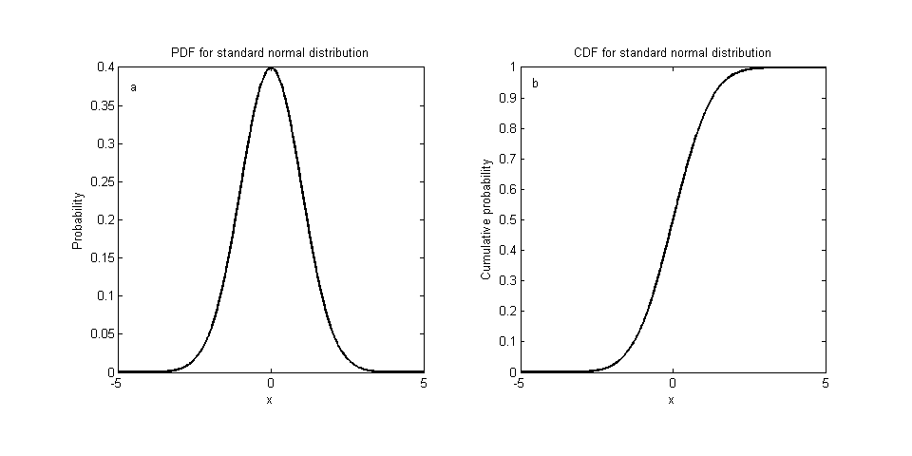
Key Terms - Statistics
Distributions
Normal/Gaussian (bell curve)
Bernoulli /Binomial
Density/Distribution functions
Relationships
Between observations/features
Independent (IV)/Dependent (DV) variables (features)
Error
Systematic/Random
Sampling
Source: http://www.webpages.uidaho.edu/phiguera/FOR504_2014/Week3_matlab_06.png

Slide 17
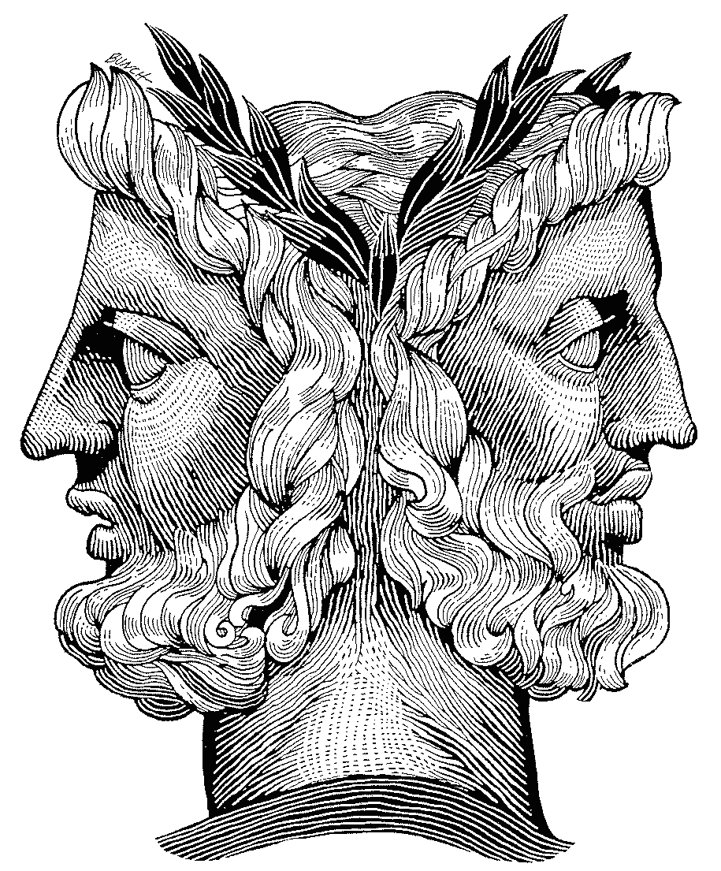
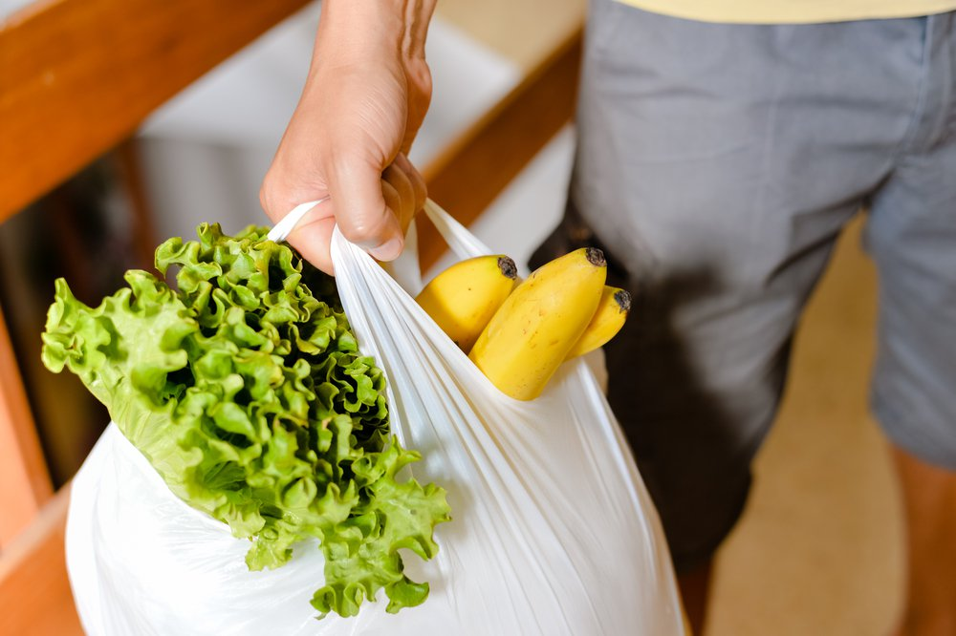

PAST
FUTURE
Statistics
Probability
Source: http://www.creationoutreach.com/sitebuildercontent/sitebuilderpictures/janus1.gif;
https://www.rd.com/wp-content/uploads/2018/04/grocery-bag.jpg;
https://ak8.picdn.net/shutterstock/videos/22275028/thumb/12.jpg?i10c=img.resize(height:160)

Slide 18
What is ‘Probability?’
Do we even really know?

Slide 19
Collective:
An ‘infinite’ sequence of observations with each observation ending in the recording of a certain Attribute. Probability cannot exist without Collectives.
Two conditions of Collectives:
‘Relative Frequency’ of some attribute must possess a ‘Limiting Value’
Limiting Values must remain the same in all partial sequences of the Collective
Example:
All throws of two dice during the course of a game (Collective) and the points thrown each time (Attribute)
Source: http://mathaholic.com/images/lawoflargenumbers.jpg
https://thumbs.gfycat.com/CluelessDefinitiveBongo-max-1mb.gif

Slide 20
Relative Frequency:
The ratio of occurrences of an Attribute to total number of observations
Limiting Value:
The expected Relative Frequency of and Attribute as a Collection approaches infinity
Randomness:
The arbitrary selection of observations and their outcomes from a Collective (‘Place Selection’) should exhibit nearly the same Relative Frequency of an Attribute
Probability:
The Limiting Value of the Relative Frequency of a given Attribute assumed to be independent of any Place Selection is called the Probability of the Attribute within the given Collective

Slide 21

Probability example
Example:
Attribute of single throw of two dice is sum of points – say ’12’
Roll 200 times, 12 appears 5 times (5/200 = Relative Frequency)
Increasing number of throws stabilizes Relative Frequency to the Limiting Value
Source: https://thumbs.gfycat.com/CluelessDefinitiveBongo-max-1mb.gif

Slide 22
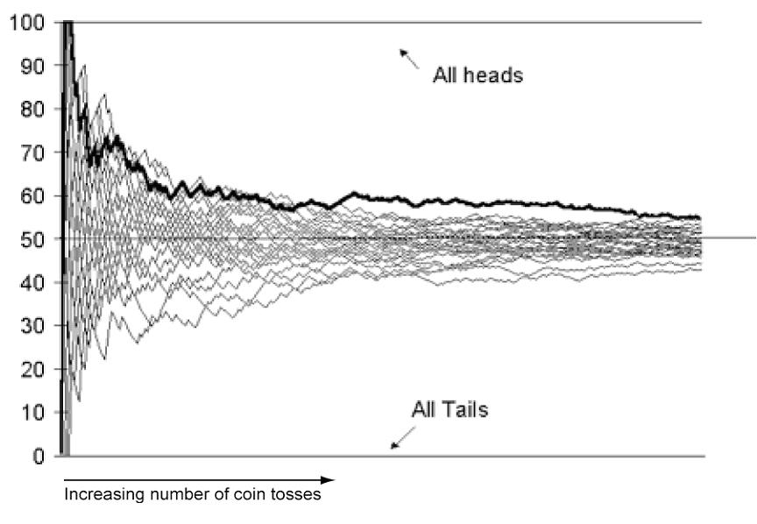
Theory of Probability
The Theory of Probability deals exclusively with frequencies in long sequences of observations
Yet since we cannot observe infinitely long sequences, can we ever know a true probability?
Frequentist “vs.” Bayesian
Source: http://mathaholic.com/images/lawoflargenumbers.jpg

Slide 23
What is ‘Machine Learning?’
Don’t worry…it’s not the AI takeover

Slide 24
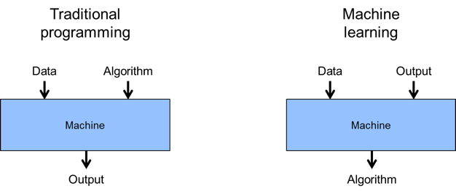
Source: https://www.talend.com/wp-content/uploads/MachineLearningTalend2.png

Slide 25
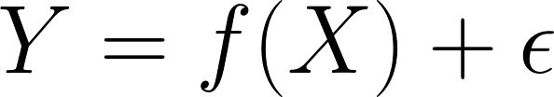
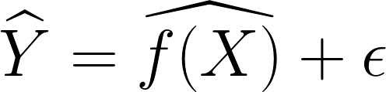
Statistical Learning/Modeling:
The mathematical formalization of relationships between features (Χ) in a data set and/or the relationships between features (X) and a “target” (Y) or “outcome”
Machine Learning:
An algorithmic approach to iteratively tuning the parameters of a Statistical Model to achieve the best estimated model – effectively training than explicitly programming.

Slide 26
What two reasons might we want to estimate f(X)?

Slide 27
Estimating Y as a function of X
Prediction:
Given a set of features (x₁, x₂,…, x_{n}) how can we best predict Y?
Two types of Error:
Reducible: Error we can eliminate by model selection, parameter tuning, etc.
Irreducible: Error inherent in our imperfect measurement of phenomenon
We don’t necessarily care about understanding the form of f(X)
Inference:
How is a given Y affected by changes in a set of features (x₁, x₂,…, x_{n})?
Relationships between Y and each x
Which features have an association with Y?
How can we best summarize x/Y relationship with a model?
We do care about understanding the form of f(X)

Slide 28
Accuracy vs. Interpretability

Slide 29
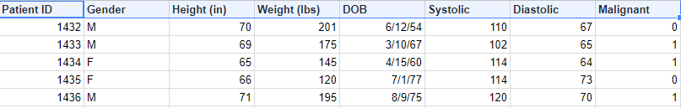
Key Terms – Machine Learning
Supervised learning – ML where each observation has an associated target/outcome
Unsupervised learning – ML where each observation does not have an associated target/outcome
Semi-supervised – ML with a little of both the above
Dependent Variable (DV)/
Target/Outcome
Observation
Independent Variables (IVs)/Features/Predictors

Slide 30
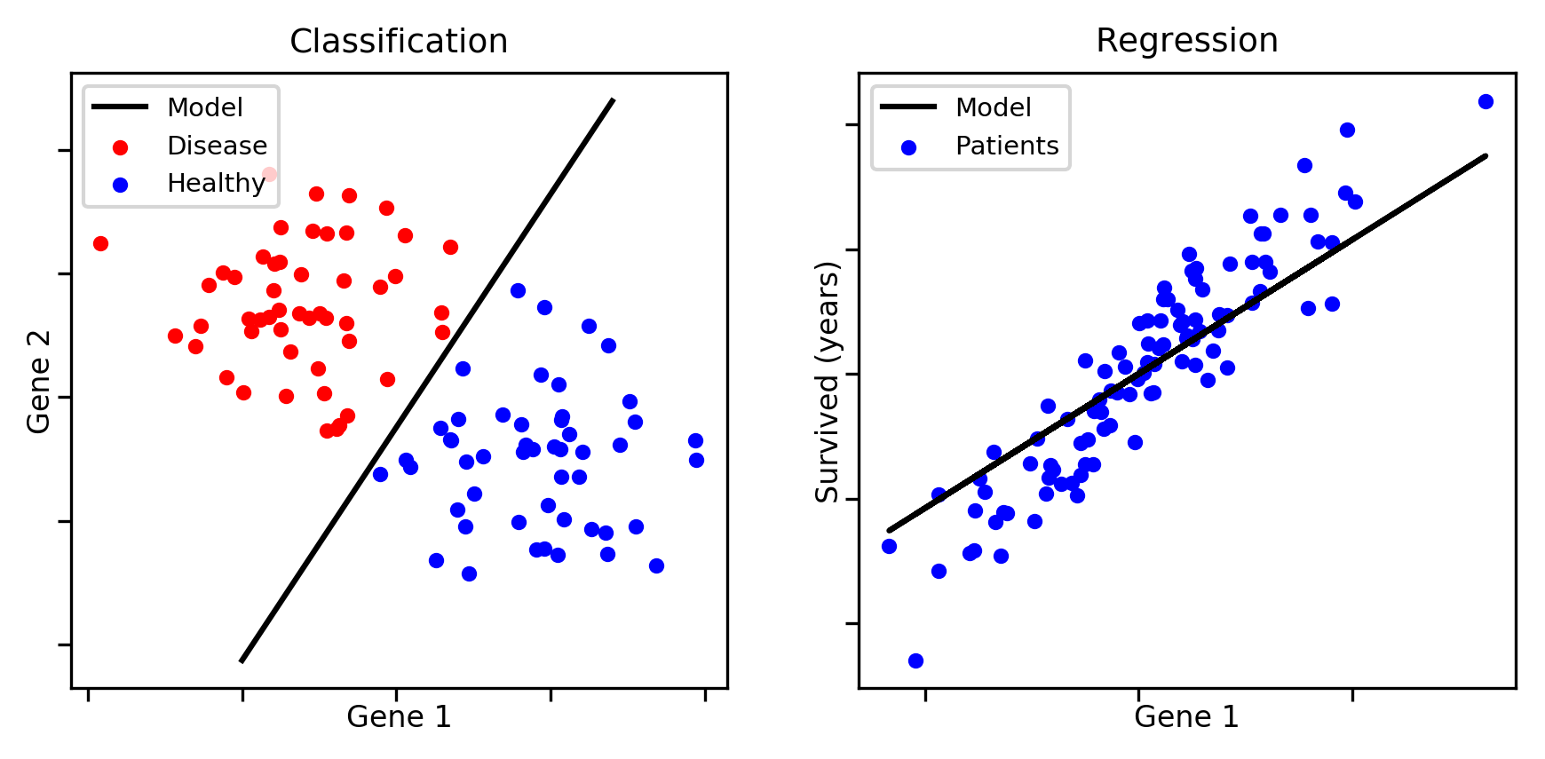
Supervised Learning
New Data
New Data
New Data
Source: https://aldro61.github.io/microbiome-summer-school-2017/figures/figure.classification.vs.regression.png

Slide 31
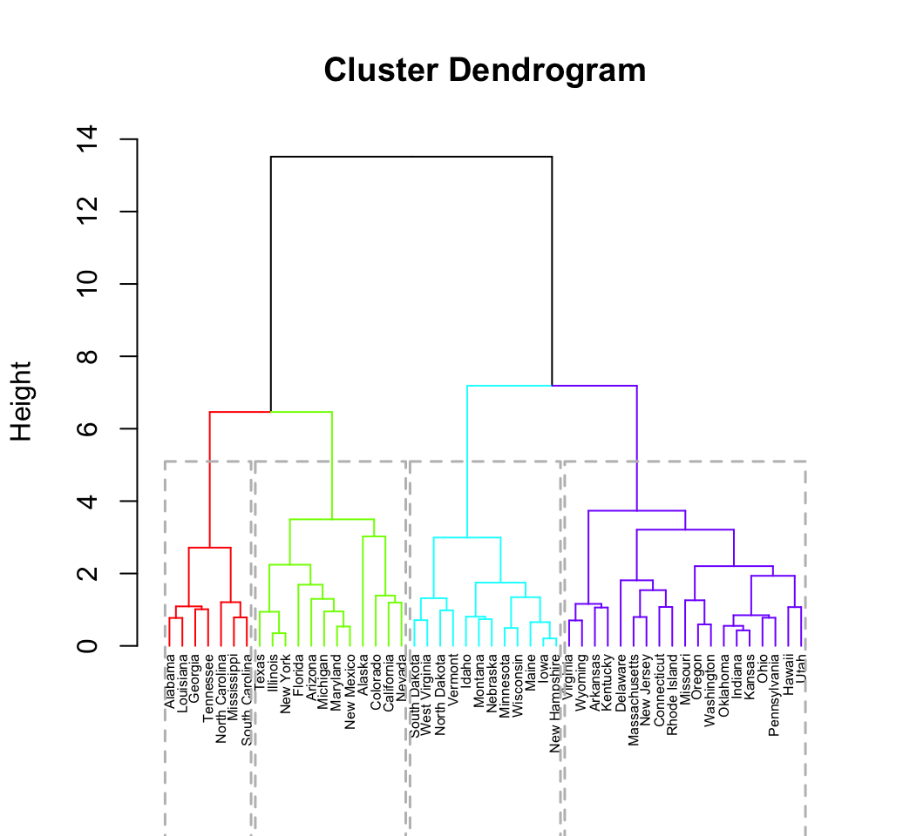
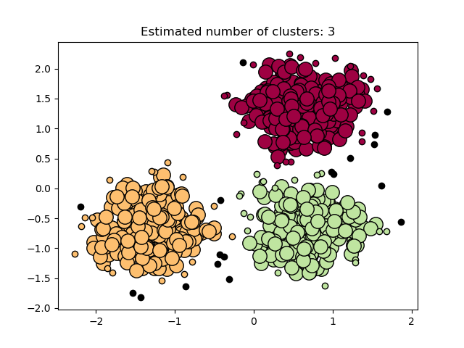
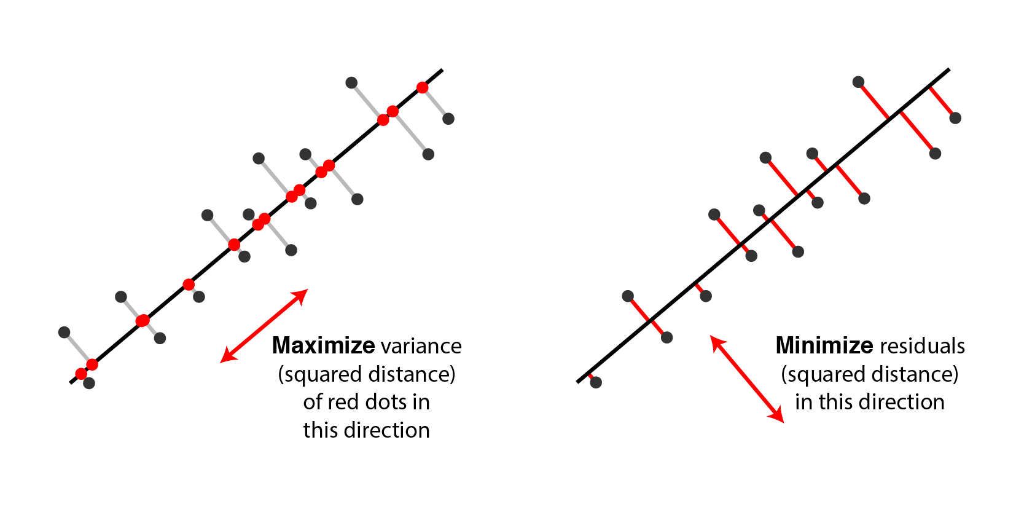
Unsupervised learning
Clustering
Dimensionality Reduction
Source: http://scikit-learn.org/stable/_images/sphx_glr_plot_dbscan_001.png; http://www.sthda.com/sthda/RDoc/figure/clustering/hierarchical-k-means-clustering-hierarchical-clustering-1.png;
http://alexhwilliams.info/itsneuronalblog/img/pca/pca_two_views.png

Slide 32
Pop Quiz
Classification or Regression?
We’d like to know if Cisco’s new product, the Cisco 300 Series Wireless Access Point, will be a market success or failure. Data is collected on similar historical products launched by both Cisco and competitors including price, marketing channel spend, product features, recalls, and whether the product was successful or not
When CPU clock time crosses a certain threshold, it’s indicative of malware infection. We suspect changes in Wi-Fi connection speed (Mbps), RAM usage, and fan speed might indicate the malware’s existence or not. We want to understand how changes in these may increase/decrease the probability of infection.
Data from Cisco is collected including annual revenue, headcount, employee demographics, and employee salaries. We want to understand what features affect salary.
Prediction or Inference?

Slide 33
Machine Learning/
Deep Learning Process

Slide 34
Why might a business want to implement a ML/DL solution?

Slide 35
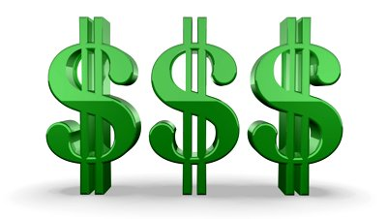
Are decisions/predictions too difficult or time consuming for humans?
Can human biases/limitations inhibit sound/objective decision making or predictions?
Will incorporating ML/DL add efficiencies to business processes?
Will incorporating ML/DL open opportunities for business growth?

Slide 36
The business case for ML/DL
Data is a strategic asset to a business
Invest in and acquire what is needed to accomplish goals
The ability for a business to extract useful knowledge from data is a competitive advantage
Data and the means to extract value from it are complimentary
A business that begins to incorporate ML/DL will need to remove data access barriers
Both ML and DL thrive on having a variety of data sources to model with
Traditional organizational structures often create “data silos”

Slide 37

Cross-industry Standard Process for Data Mining (CRISP-DM)
Source: https://upload.wikimedia.org/wikipedia/commons/b/b9/CRISP-DM_Process_Diagram.png

Slide 38
Process Phases for Applied ML/DL - CRISP-DM
Business Understanding
The most important phase!
The right answers to the wrong questions
Framing business problems as data problems
Decomposing large problems to smaller ones
Defining baselines
Success criteria/Expected Value
Data Understanding
The second most important phase!
Strengths/limitations of the “raw material”
Data cost and benefits
Collect, describe, explore, verify - EDA
Data needs in Expected Value context
Data Preparation
Selecting data/Data integration
Feature extraction/engineering
Cleaning data based on EDA
Standardization/Normalization
Missing values
Logic checks
Modeling
Supervised/unsupervised learning
Model selection
Classification or Regression?
Prediction or Inference?
Accuracy or Interpretability?
Model assumptions
Model comparison/assessment
Parameter tuning
Evaluation
Does selected model(s) satisfy original goal(s)?
Staged deployment or test/control live deployment?
Stakeholder sign-off
Regulatory concerns
Accuracy or Interpretability
Go or no-go?
Deployment
Integration in information system/business process
Model socialization
Monitoring/maintenance
Automation in production
Documentation/reporting
Debrief
Rinse and repeat! Welcome to the life of a data scientist!
Source: https://upload.wikimedia.org/wikipedia/commons/b/b9/CRISP-DM_Process_Diagram.png

Slide 39
“CRISP-DM”
Step-by-step guide: https://www.the-modeling-agency.com/crisp-dm.pdf
Visual guide: https://exde.files.wordpress.com/2009/03/crisp_visualguide.pdf

Slide 40
What is ‘Big Data?’
Are you sick of hearing about it yet? OK, we’ll cover it quick…

Slide 41
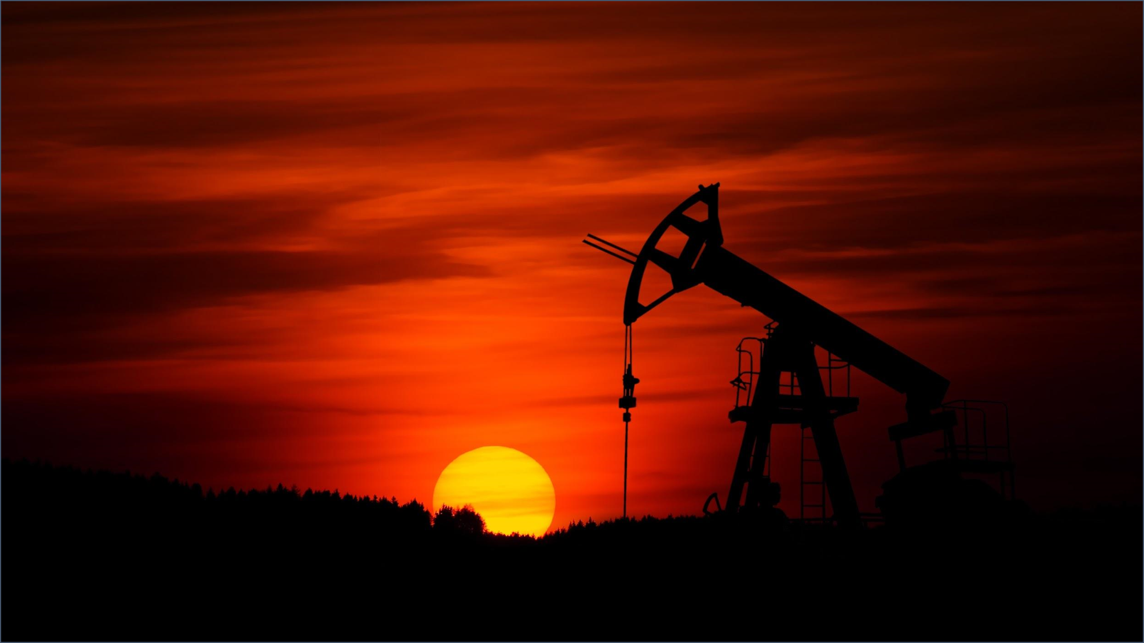

Slide 42

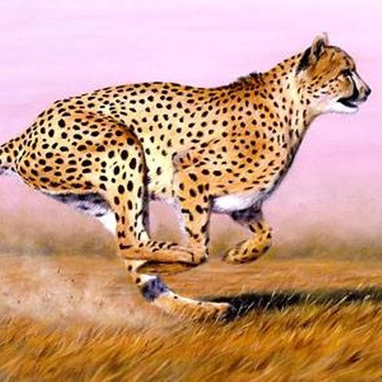
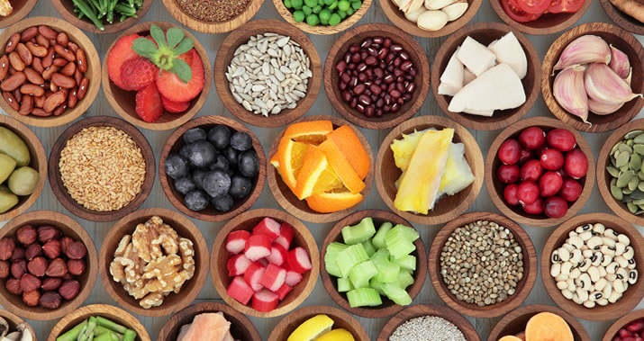
VOLUME
VELOCITY
VARIETY
Source: https://upload.wikimedia.org/wikipedia/commons/thumb/4/4b/Long_Room_Interior%2C_Trinity_College_Dublin%2C_Ireland_-_Diliff.jpg/794px-Long_Room_Interior%2C_Trinity_College_Dublin%2C_Ireland_-_Diliff.jpg;
https://sciencing.com/how-fast-does-cheetah-run-4577113.html;
http://liwli.com/seven-secrets-maintaining-healthy-diet/

Slide 43
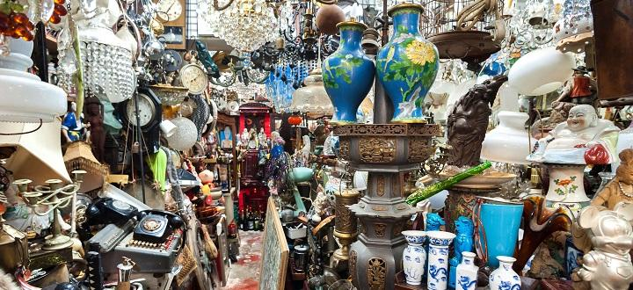
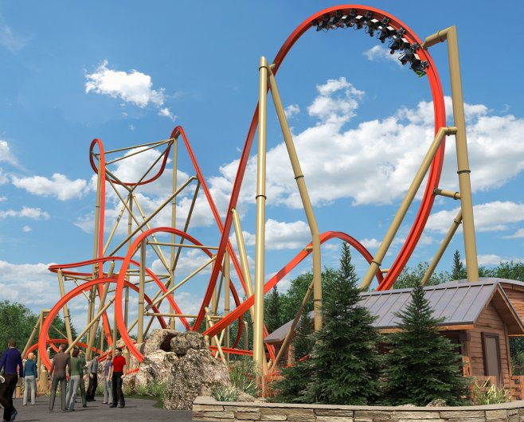

VERACITY
VOLATILITY
VALUE
Source: https://www.york.ac.uk/research/themes/clutter-heritage/;
https://www.eastbaytimes.com/2017/08/16/get-ready-for-railblazer-the-new-roller-coaster-at-great-america/
https://pando.com/2014/02/26/fortune-500-companies-receive-63-billion-in-subsidies/

Slide 44
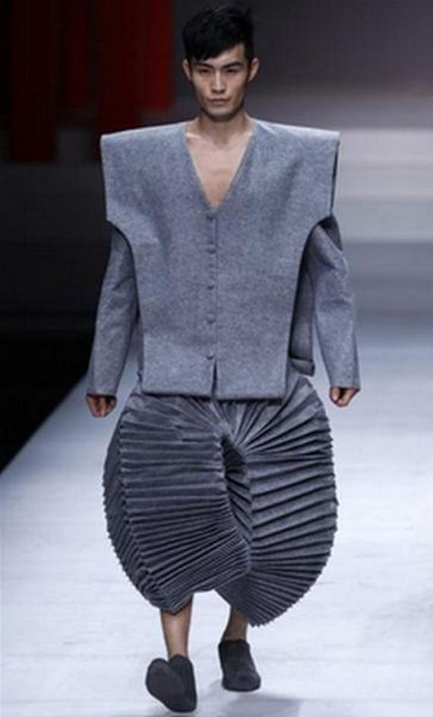
…and SO Vogue!
Source: http://www.simplerman.com/blog/2013/03/30/fashion-can-be-so-weird

Slide 45
Big Data in ML/DL
Big Data is inherently unmanageable on localized systems and traditional relational databases
Ingestion, storage, compute, distribution
Cloud platforms provide availability, fault tolerance, scalability, and elasticity
Static (on-site) vs. dynamic, distributed storage and compute (i.e. Hadoop and Spark, respectively)
Amazon Web Services (AWS), Google Cloud Platform, Microsoft Azure
Machine learning and especially deep learning applications excel with greater amounts of data

Slide 46
When might having “Big Data” not be enough to succeed with ML/DL?

Slide 47
Data Cleansing and EDA

Slide 48
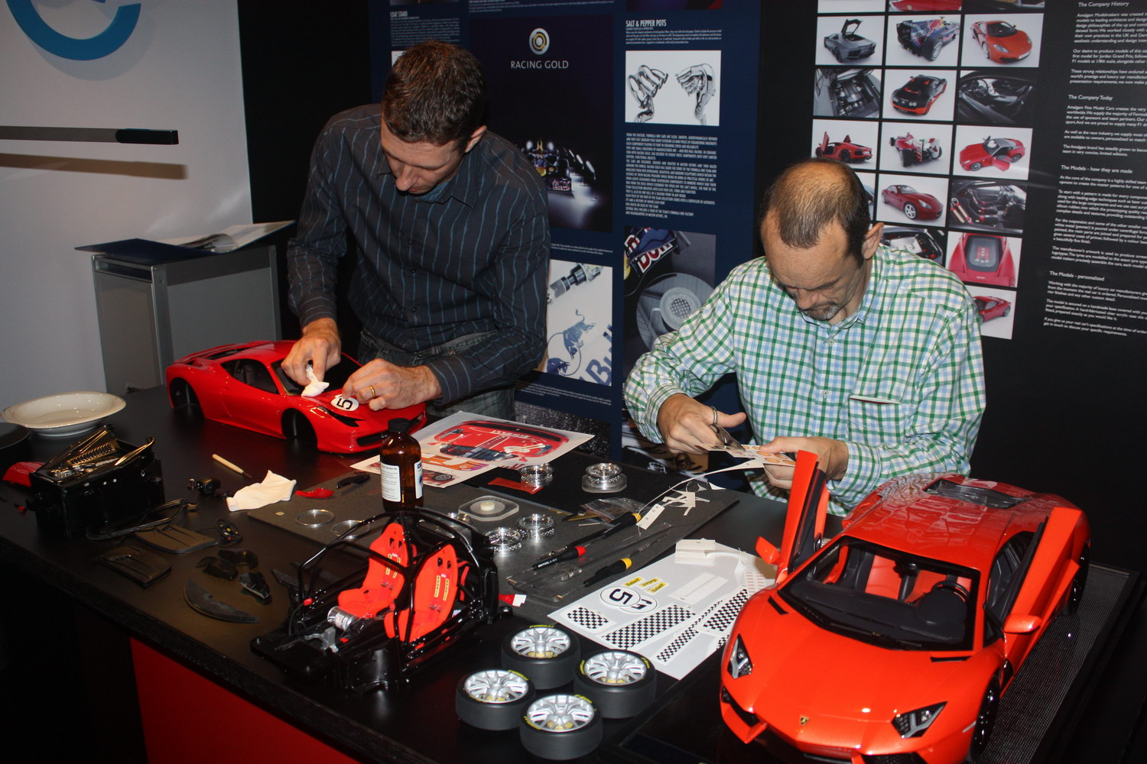

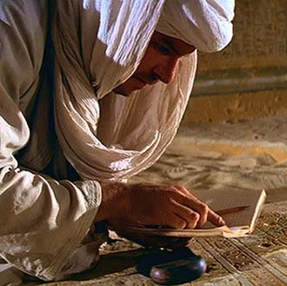
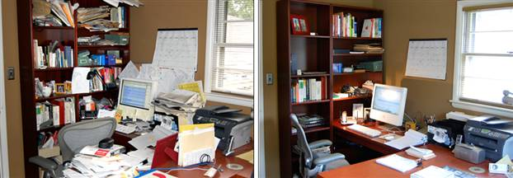
REALITY
FANTASY
Source: http://www.bristol-business.net/wp-content/uploads/2016/05/IMG_3040.jpg; http://www.onter.net/cinema/jones_b.jpg;
http://www.fvi.edu/wp-content/uploads/2017/07/super-computer-nerd.jpg;
http://www.evetahmincioglu.com/web/blog/wp-content/uploads/2009/09/mess.jpg

Slide 49
EXPLORATION
PREPARATION
ANALYZATION

Slide 50
What makes data “messy?”
PatientID
Sex
Height
Weight (lbs)
DOB
Sys
Dia
Malignant
Numeric
String
Int
Int
String
String
String
Bool
123
162.34
1960-12-2
$and1?
5
1/1/00
Missing values
Outliers/Unconstrained ranges
Data formats
Data corruption
Data entry errors
Measurement scales
Data integration mismatches
Data type mismatches
EXPLORATION

Slide 51
What makes data “tidy?”
Cleaning messy data
Structuring cleansed data to facilitate analysis:
A data set is collection of values – every value belongs to a feature/variable (column) and an observation (row)
Each observation contains all values measured on the same unit
One feature/variable per column, one observation per row, a collection of observations forms a table
PREPARATION

Slide 52
Customer | 18-24 Y | 25-34 Y | 35-44 Y | 45-54 Y | 55+ Y
1 | 12 | 42 | 44 | 10 | 5
2 | 34 | 12 | 76 | 87 | 15
3 | 54 | 23 | 54 | 69 | 12
Customer | Prod./Date | Svc. Plan | Return
1 | Aironet-12/2 | A | No
2 | Aironet-1/4 | CC | No
3 | Aironet-10/8 | X1 | Yes
Column headers are values, not variable names
Multiple variables are stored in one column
Customer | Year | Purch. | Mth. 1 | Mth. 2 | Mth. 3
1 | 2017 | First | 1254 | 6543 | 3423
1 | 2017 | Last | 5435 | 12654 | 75643
1 | 2018 | First | 234 | 312 | 435
1 | 2018 | Last | 765 | 765 | 765
Variables are stored in both rows and columns
Customer | Year | Purch. | Mth. 1 | Mth. 2 | Mth. 3
1 | 2016 | First | 1254 | 6543 | 3423
1 | 2017 | First | 5435 | 12654 | 75643
1 | 2018 | First | 234 | 312 | 5435
Customer | Year | Purch. | Mth. 4 | Mth. 5 | Mth. 6
1 | 2016 | First | 4324 | 2387 | 1098
1 | 2017 | First | 4325 | 22 | 1543
1 | 2018 | First | 65785 | 3472 | 34569
One type in multiple tables
PREPARATION

Slide 53
“Tidy Data”
by Hadley Wickham
https://www.jstatsoft.org/article/view/v059i10/v59i10.pdf

Slide 54
Exploratory Data Analysis (EDA)
Measures of Central Tendency
Measures of Dispersion
STATISTICS!
Data Types
Distributions
EXPLORATION
ANALYZATION

Slide 55
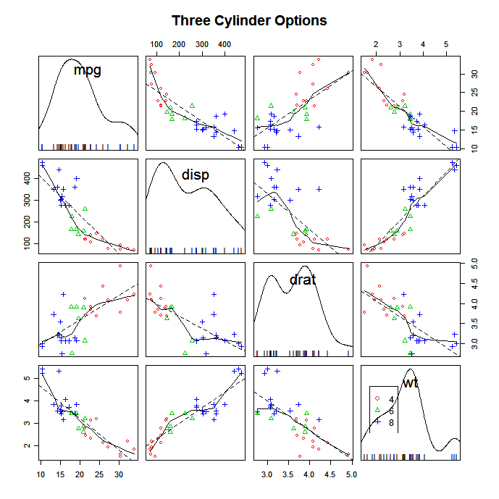
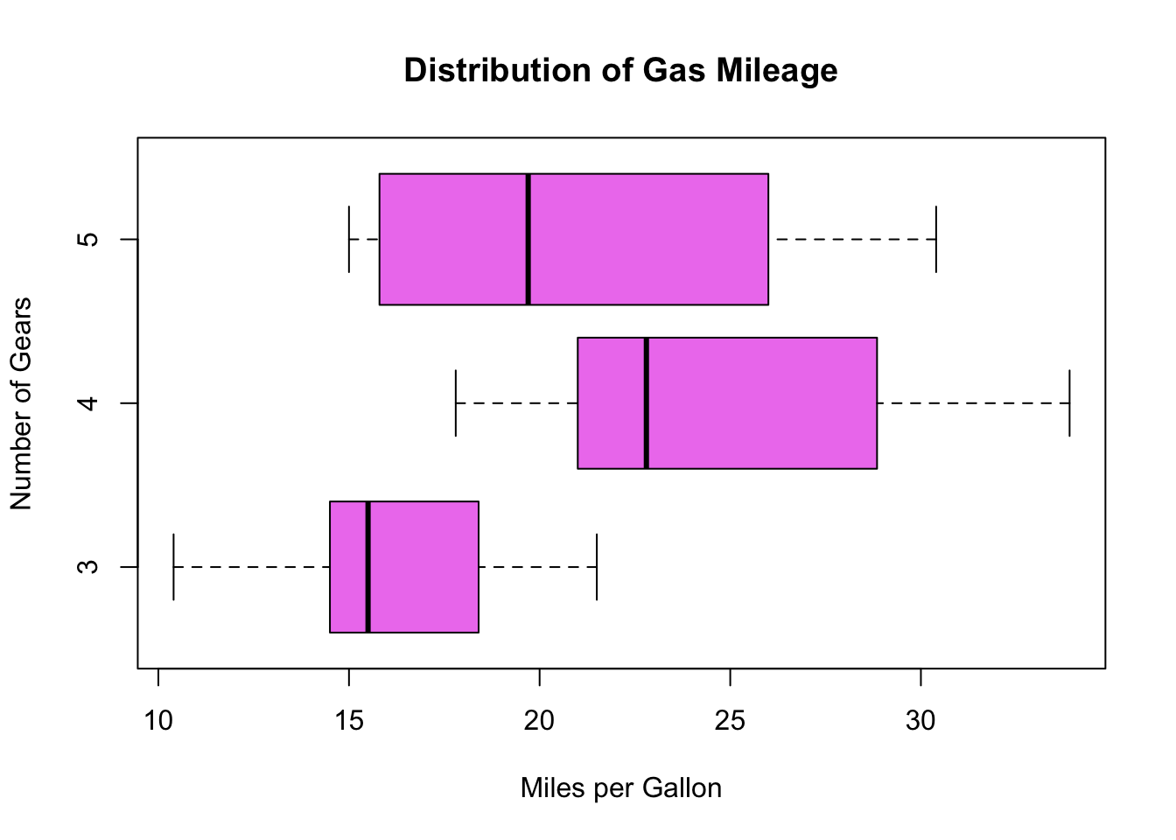
Exploratory Data Analysis (EDA)
RELATIONSHIPS!
EXPLORATION
ANALYZATION
Source: http://homepages.gac.edu/~anienow2/MCS_142/R/R-boxplot2_files/figure-html/unnamed-chunk-2-1.png;
https://www.statmethods.net/graphs/images/spmatrix3.png

Slide 56
Pop Quiz
True or False?
Tidy data?
The mean is robust against data outliers
Customer | Prod. | Cost | Week 1 | Week 2 | Week 3
1 | Catalyst 3650 | 350 | -- | 132 | 154
2 | MR33 | 125 | 34 | 25 | 24
3 | Aironet 3800 | 250 | 122 | 23 | --
4 | MR33 | 125 | 35 | 39 | 41
5 | SB 100 Series | 100 | 234 | 432 | 111
6 | SB 100 Series | 100 | 213 | 345 | !13@
The median is robust against data outliers

Slide 57
Machine Learning/
Deep Learning Algorithms

Slide 58
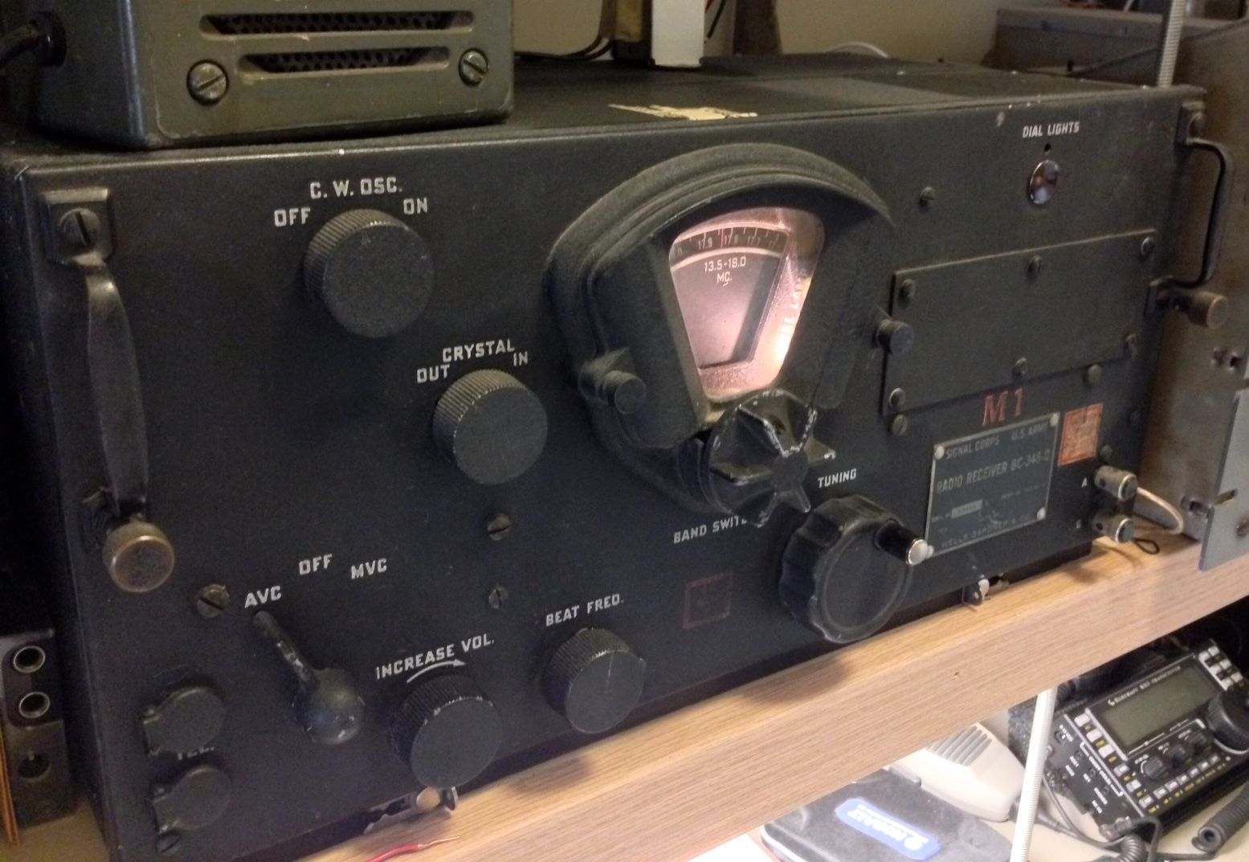
Source: https://swling.com/blog/wp-content/uploads/2014/04/SignalCorps-BC-348-Q.jpg

Slide 59
Supervised Learning
New Data
New Data
New Data
Source: https://aldro61.github.io/microbiome-summer-school-2017/figures/figure.classification.vs.regression.png

Slide 60
Linear Regression
A SL simple approach who’s value cannot be overstated

Slide 61
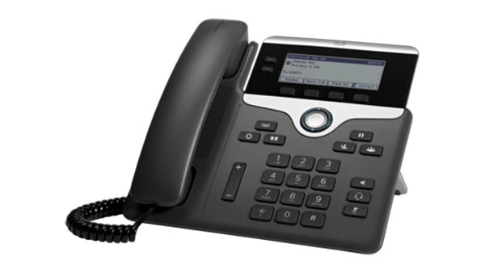
Cisco IP Phone 7821
Is there a relationship between advertising budget and sales?
How strong is the relationship between advertising budget and sales?
Which media contribute to sales?
Is there synergy among the advertising media?
Is the relationship linear?
Source: https://www.cisco.com/c/dam/assets/swa/img/600/KN37030-600x338.png

Slide 62
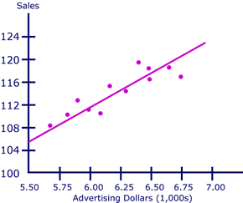
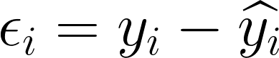
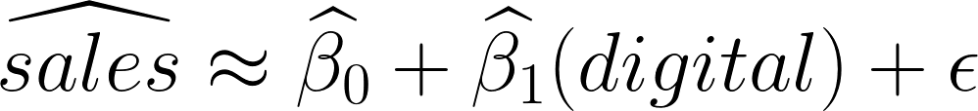
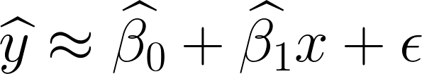
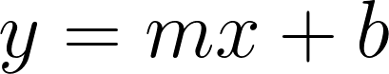
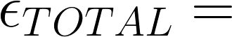
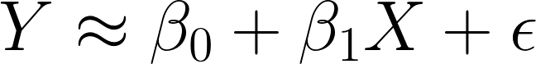
Source: http://ci.columbia.edu/ci/premba_test/c0331/images/s7/6929401738.gif

Slide 63
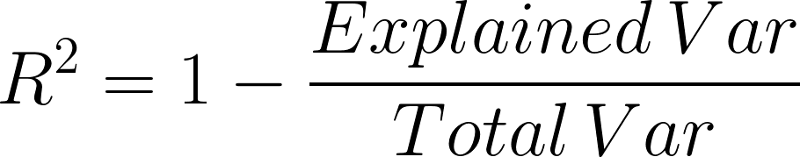
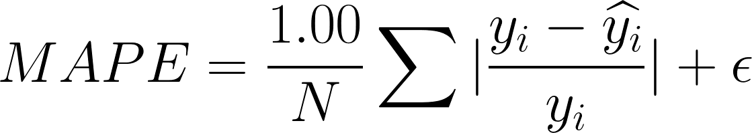
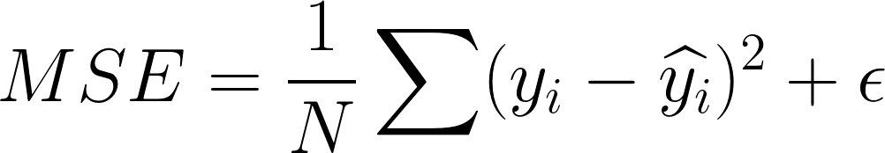
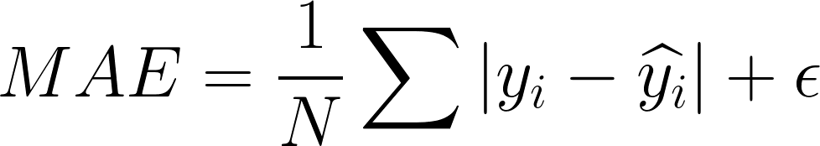
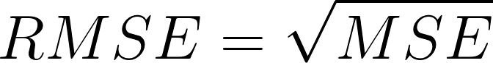
Source: http://ci.columbia.edu/ci/premba_test/c0331/images/s7/6929401738.gif

Slide 64
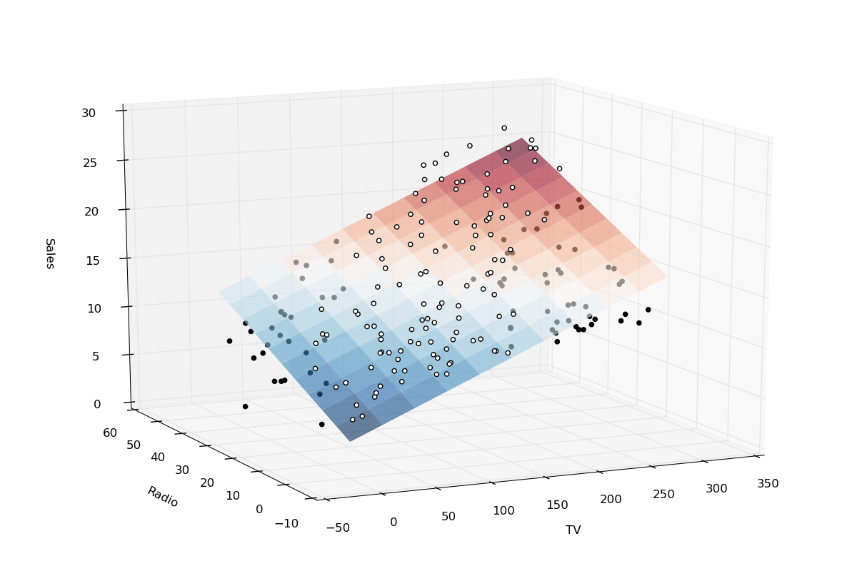
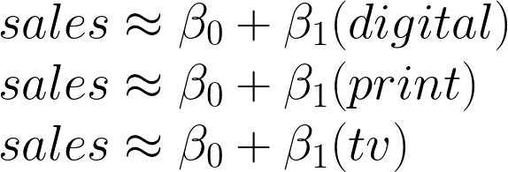
Source: https://i.stack.imgur.com/cNJQs.png

Slide 65
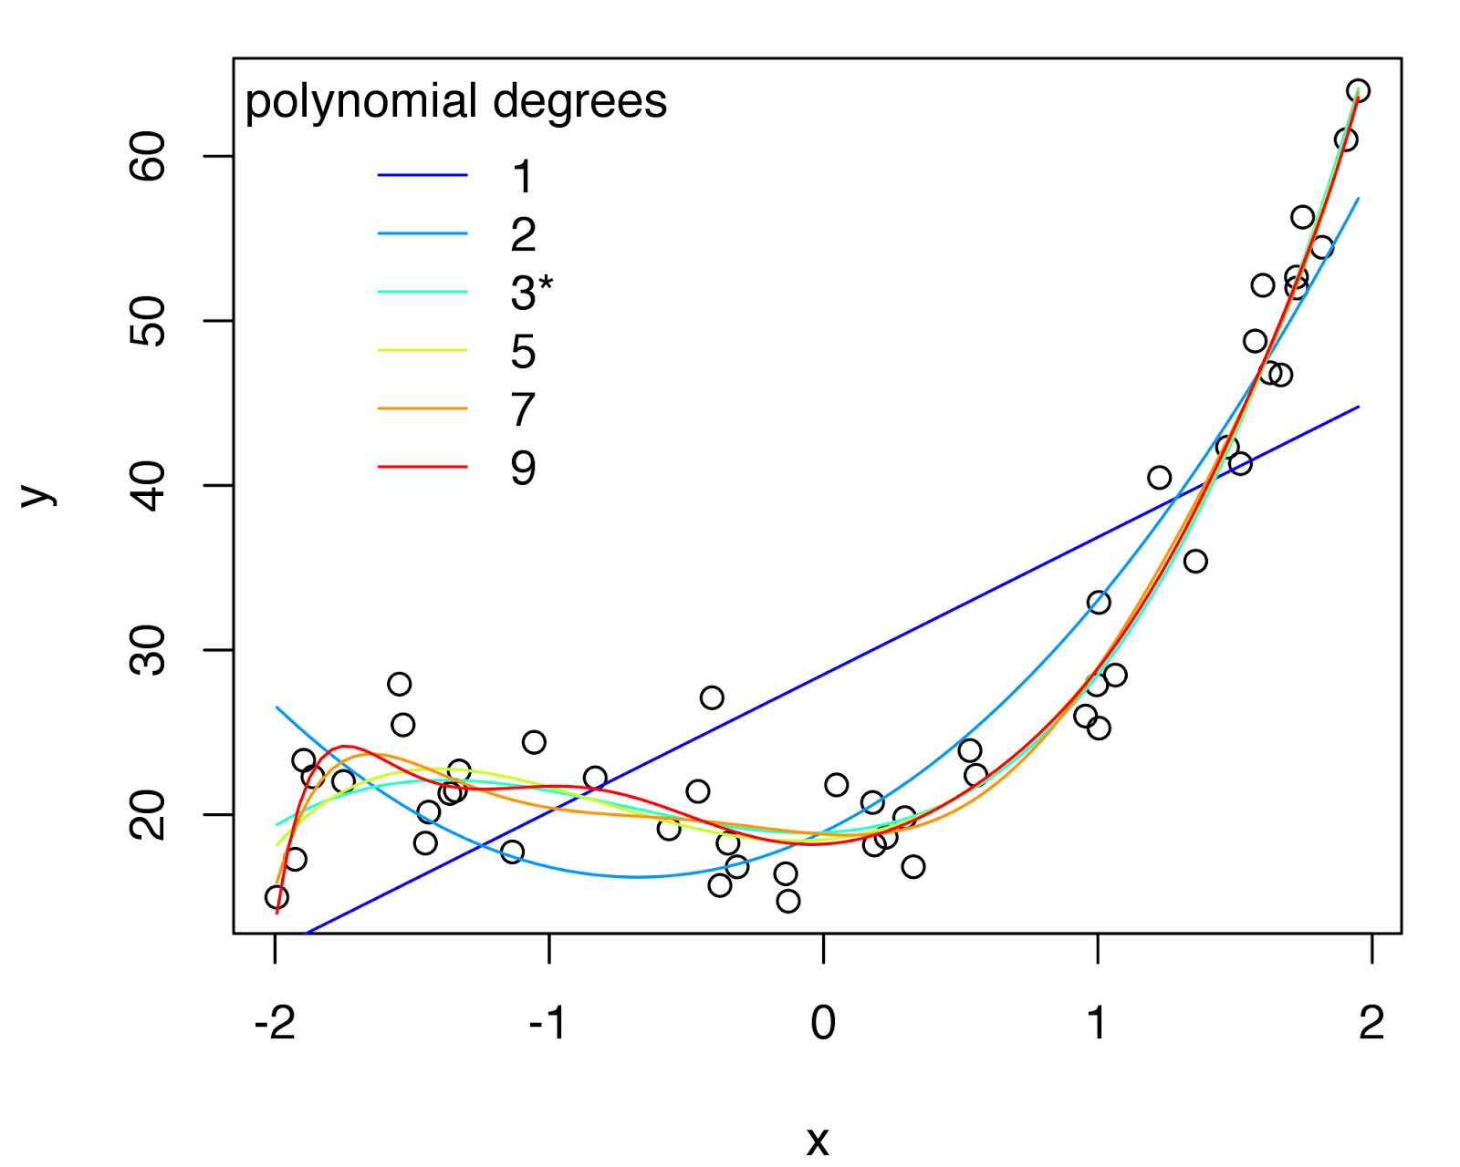
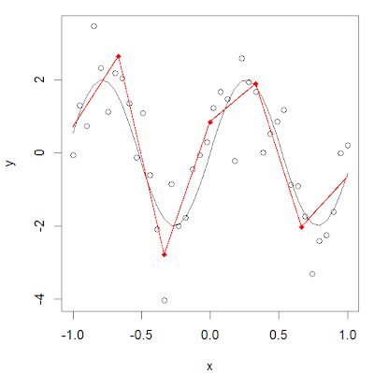
Generalized Linear Models (GLMs) - Regression extensions
Non-linear regression
Polynomial regression
Regression splines
Regularization regression
“Shrinks” estimated coefficients
Reduces impact of collinearity
Built in feature selection
LASSO regression (L1)
Ridge regression (L2)
Elastic Net (L1/L2 hybrid)
Source: http://4.bp.blogspot.com/-6Rcdu0lWFGw/U2TuLyAJC4I/AAAAAAAAEoI/hUmT2S8y2Lo/s1600/model_fit~terms.png; https://www.analyticsvidhya.com/blog/2018/03/introduction-regression-splines-python-codes/

Slide 66
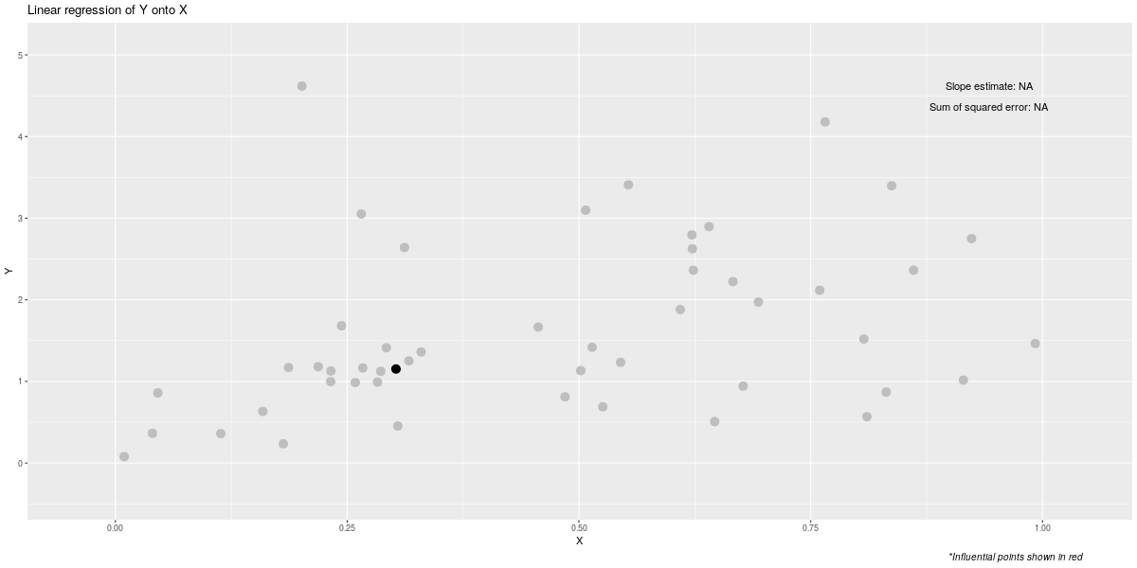
Linear Regression - Animated
Source: https://imgur.com/a/ZQnK40X

Slide 67
Logistic Regression
Generalizing the linear model for classification

Slide 68
Classification
Classification problems occur often in business, sometimes more so than regression problems
Examples:
Online bank services need to determine if transactions are fraudulent or not based on transaction history, IP address, etc.
Different types of DoS attacks need to be classified in order to achieve the best approach for mitigation using network performance features
Logistic regression assumes a similar functional form to linear regression but adds a transformative step to assume probability estimates for qualitative outcomes

Slide 69
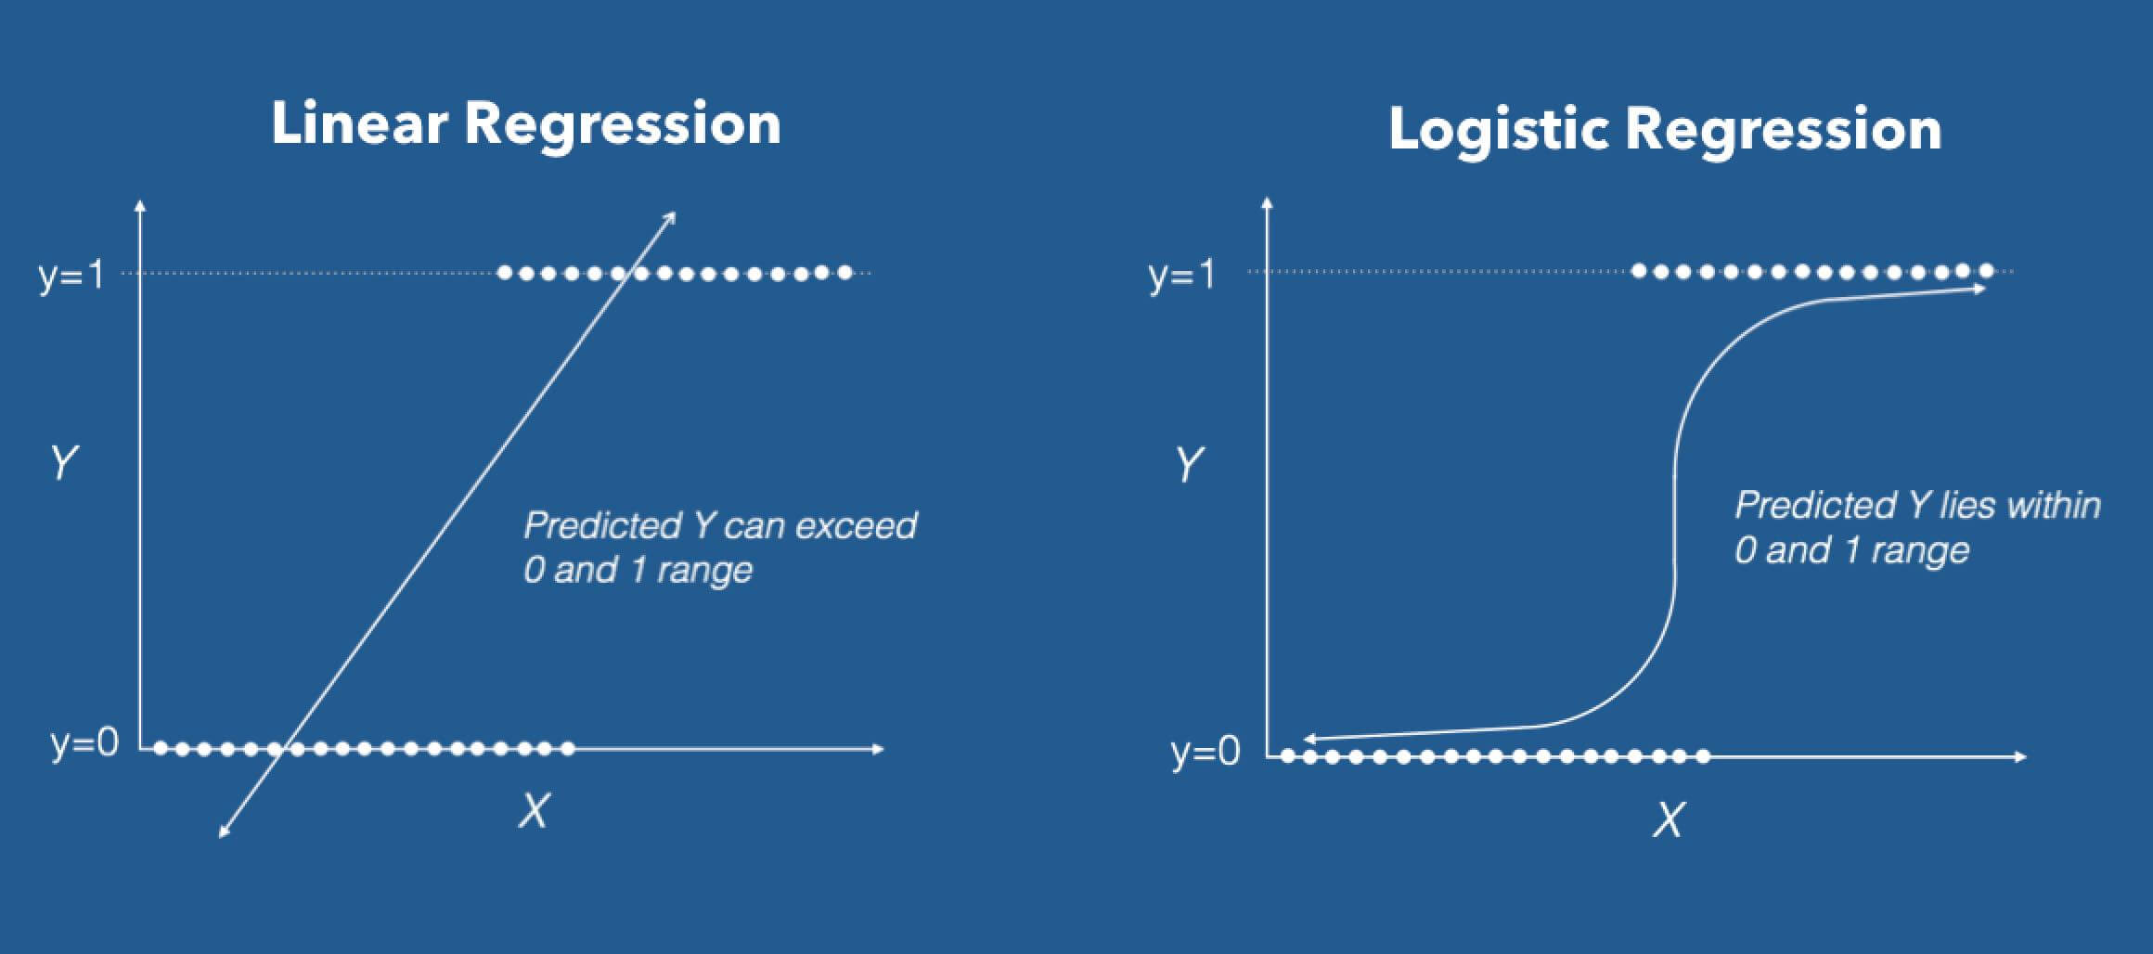

Slide 70



Logistic regression
Simple model predicts probability of binary outcome (yes/no, fraud/legit, DoS traffic/user traffic):
To constrain outcomes between 0 and 1 use logistic function:
Linear Regression Line
Logistic Regression Line (“Sigmoid”)
Source: http://vlambda.com/img?url=http://mmbiz.qpic.cn/mmbiz_png/g4neqjUClA7KA7qcdlDaHWv7PM3B4svZKL0VYibia7ibKvzwf6OuupggzfmafYRasjzEkCw4eG9sb021qbWLjamLg/0?wx_fmt=png

Slide 71


Logistic regression
Logit can be rewritten as
This is called the odds
By taking the natural log of both sides, we get the logit:
Source: http://vlambda.com/img?url=http://mmbiz.qpic.cn/mmbiz_png/g4neqjUClA7KA7qcdlDaHWv7PM3B4svZKL0VYibia7ibKvzwf6OuupggzfmafYRasjzEkCw4eG9sb021qbWLjamLg/0?wx_fmt=png

Slide 72
Logistic regression
Linear regression:
Increasing X by one unit changes Y by β₁
Estimate β by minimizing RSS
Logistic regression
Increasing X by one unit changes the logit of Y by β₁
Estimate β by maximum likelihood estimation
“What values for β in our logistic function yield values close to ‘1’ for DoS = yes and vice versa?”
Source: http://vlambda.com/img?url=http://mmbiz.qpic.cn/mmbiz_png/g4neqjUClA7KA7qcdlDaHWv7PM3B4svZKL0VYibia7ibKvzwf6OuupggzfmafYRasjzEkCw4eG9sb021qbWLjamLg/0?wx_fmt=png

Slide 73

Logistic regression
What is the probability that a DoS attack is underway given a website’s latency (say 1.5 sec)?
 | Coef.
Intercept (β₀) | 1.4
Site latency (β₁) | .34
Source: http://vlambda.com/img?url=http://mmbiz.qpic.cn/mmbiz_png/g4neqjUClA7KA7qcdlDaHWv7PM3B4svZKL0VYibia7ibKvzwf6OuupggzfmafYRasjzEkCw4eG9sb021qbWLjamLg/0?wx_fmt=png

Slide 74
Lab 1 – EDA and Regression
Go to: https://colab.research.google.com/notebooks/welcome.ipynb
You may be prompted with a pop-up window. Close this and go to “File → Upload notebook…”
Upload “Lab 1 – EDA and Regression.ipynb”
Read the lab and follow the instructions. You will also be given two data files “HousingData.csv” and “Admission_Predict.csv” to upload.
Good luck and play around!

Slide 75
Decision Trees
Regression AND Classification, PLINKO-style

Slide 76




Observation
Nodes
Terminal Nodes
Source: http://static.wixstatic.com/media/00bcca_88746fd4700640e491babf05877284f7~mv2.gif; https://ih1.redbubble.net/image.153917460.8108/st%2Csmall%2C215x235-pad%2C210x230%2Cf8f8f8.lite-1.jpg; http://4.bp.blogspot.com/_mQeMUaCbNl8/TCgwDH21bYI/AAAAAAAAFdE/NudI3Q8BFqg/s1600/Plinko.JPG; https://vignette.wikia.nocookie.net/priceisright/images/8/83/Plinko_%28C%29_3.jpg/revision/latest?cb=20120506145333

Slide 77

Decision trees
Structured and visualized similar to a flow chart
Key terms:
Node – A feature in our data
Branch – A “test” performed on the preceding node
Terminal node – A node with no further branches leading to a decision
Variety of methods for splitting features
Creates linear partitions within data set
Decision rules likened to “if/and/then” statements
Source: https://upload.wikimedia.org/wikipedia/commons/4/46/ID3_algorithm_decision_tree.png

Slide 78

Importance
Source: http://cdn.iopscience.com/images/1749-4699/5/1/015004/Full/csd422281fig1.jpg

Slide 79
Decision trees (or “CART” for “Classification and Regression Trees”)
Regression
Quantitative outcome
Divide “feature space” into boxes to minimize RSS
Splits using “recursive binary splitting”
“Top-down” and “greedy”
Continues on until stopping criteria is met or tree is “pruned”
Classification
Qualitative outcome
Divide “feature space” to minimize misclassification
Splits using “recursive binary splitting”
“Top-down” and “greedy”
Continues on until stopping criteria is met or tree is “pruned”

Slide 80

Pruning
Will build indefinitely until each observation is in a terminal node
“Overfitting!” (more later)
Regression – Cost complexity
Classification – Gini Impurity
Source: https://78.media.tumblr.com/tumblr_lrgsolw7wS1qig3dlo1_500.gif

Slide 81
Pruning
Cost complexity pruning:
Split data set with k-fold CV (more later)
Build k-1 trees with different “complexities” (# of terminal nodes)
Calculate the RSS on “test” set k times
Choose tree with minimum RSS
Source: https://78.media.tumblr.com/tumblr_lrgsolw7wS1qig3dlo1_500.gif

Slide 82

Pruning
Gini Impurity:
Optimize terminal nodes’ predicted class/proportion of correct classes within (“purity”)
One minus squared probability of selecting each class within a node– smaller is better
Similar evaluation techniques include “cross-entropy” and “information gain”
Source: https://78.media.tumblr.com/tumblr_lrgsolw7wS1qig3dlo1_500.gif

Slide 83

Source: https://i.stack.imgur.com/yE8JP.png

Slide 84



Pop Quiz (Part 1)
Class | Node 1 | Node 2 | Node 3 | Total
A | 5 | 4 | 0 | 9
B | 10 | 2 | 8 | 20
Total | 15 | 6 | 8 | 29
Calculate the Gini Impurity for each terminal node shown in the table

Slide 85



Pop Quiz (Part 2)
T
F
Create a decision tree using the feature space on the left and vice versa for the right

Slide 86
Lab 2 – Decision Trees
Go to: https://colab.research.google.com/notebooks/welcome.ipynb
You may be prompted with a pop-up window. Close this and go to “File → Upload notebook…”
Upload “Lab 2 – Decision Trees.ipynb”
Read the lab and follow the instructions. You will also be given two data files “HousingData.csv” and “Admission_Predict.csv” to upload.
Good luck and play around!

Slide 87
Clustering
Uncovering unknown subgroups in data

Slide 88

Source: https://automizy.com/wp-content/uploads/2016/04/audiencesegmentation.png

Slide 89
K-Means Clustering
An effective one-parameter clustering algorithm

Slide 90

K-Means Clustering – What Makes a Good Cluster?
K-Means attempts to find naturally-occurring clusters of data points based on the distance between them
K-Means randomly generates centroids within the feature space to find the centers of each cluster
Number of clusters depends on value of K chosen a priori
Source: http://alexhwilliams.info/itsneuronalblog/img/clustering/clustering_01.png

Slide 91
K-Means Clustering – What’s The Algorithm?
Choose a value for K – this will be the number of data clusters you end up with and the number of centroids you randomly generate
The distance between each data point and centroid is calculated – points are “assigned” to the centroid they are closest to
By calculating the “Squared Euclidian Distance” of each data point, q_{i} , to each other data point, p_{i}
Centroids are repositioned to be at the mean value of their assigned data points’ measurements
Steps 2 and 3 are iterated until centroids no longer reposition (convergence)

Slide 92

Obs. | X1 | X2 | X3
1 | 18 | 20 | 14
2 | 15 | 13 | 19
3 | 23 | 19 | 10
4 | 24 | 12 | 15
5 | 11 | 12 | 13
Obs. | X1 | X2 | X3
D1 | (18-11)² = 49 | 64 | 1
D2 | (15-11)² = 16 | 1 | 36
D3 | 144 | 49 | 9
D4 | 169 | 0 | 4
Sum
= 114
= 53
= 202
= 173
Sqrt
= 10.7
= 7.3
= 14.2
= 13.2

Slide 93

K-Means Clustering - Visualized
Source: https://i.pinimg.com/originals/87/65/9d/87659da86643e96b0d714770643aac14.gif

Slide 94
Hierarchical Clustering
A many-to-one clustering approach

Slide 95
Hierarchical vs. K-Means Clustering
K-Means
Requires the number of clusters a priori
Top-down approach
Creates clusters using Euclidian distance
Produces clusters and centroids that can be plotted visually
Hierarchical
Does not require number of cluster a priori
Bottom-up approach
Creates clusters using a variety of “linkage” techniques
Produces a “dendrogram” that allows cluster selection after running the algorithm

Slide 96

Single Linkage
Complete Linkage
Average Linkage
Source: https://www.researchgate.net/profile/Pamela_Guevara/publication/281014334/figure/fig57/AS:418517879934980@1476793847581/The-three-linkage-types-of-hierarchical-clustering-single-link-complete-link-and.jpg

Slide 97

Source: https://media.giphy.com/media/pSNCWCEAsgrAs/source.gif

Slide 98
Lab 3 – Clustering
Go to: https://colab.research.google.com/notebooks/welcome.ipynb
You may be prompted with a pop-up window. Close this and go to “File → Upload notebook…”
Upload “Lab 3 – Clustering.ipynb”
Read the lab and follow the instructions. You will also be given two data files “HousingData.csv” and “Admission_Predict.csv” to upload.
Good luck and play around!

Slide 99
Parameter Tuning and Model Evaluation

Slide 100
How can we check our work if we only have a single data set to build our model?

Slide 101

TRAINING
TESTING

Slide 102
TRAINING
TESTING
VALIDATION

Slide 103
K-Fold Cross Validation
TESTING
TRAINING
1st Iteration
2nd Iteration
3rd Iteration
. . .
kth Iteration

Slide 104


Model Performance Metrics – Minimize the Cost Function
Regression
“Mean Squared Error”:
Square the difference between predictions/actuals
Sum them
Divide by number of observations
Classification
“Misclassification Rate”:
“Sensitivity”:
Proportion of “true positives” predicted to total
“Specificity”:
Proportion of “true negatives” predicted to total
“Accuracy”:
Proportion of both “true positive/negative” to total

Slide 105

Source: https://upload.wikimedia.org/wikipedia/commons/a/a2/Preventive_Medicine_Statistics_Sensitivity_TPR%2C_Specificity_TNR%2C_PPV%2C_NPV%2C_FDR%2C_FOR%2C_ACCuracy%2C_Likelihood_Ratio%2C_Diagnostic_Odds_Ratio_2_Final.png

Slide 106
Bias:
Error introduced by approximating a simple model to complex data
More flexible = Less bias
Variance:
The amount our estimated model would change if fit using new data to “train” it.
More flexible = More variance

Slide 107


The Bias/Variance Model Trade-Off
Source: https://cdnpythonmachinelearning.azureedge.net/wp-content/uploads/2017/09/Overfitting.png?x31195
Source: https://i.stack.imgur.com/alkeM.png

Slide 108
Ensemble Methods
Because sometimes two models (or two hundred!) are better than one

Slide 109


Source: https://www.cityofhope.org/image/1430331969978-187494972.jpg;
http://www.crackerjackgreenback.com/wp-content/uploads/2008/12/50-stock-portfolio-lg.jpg

Slide 110
Ensembles vs. Single Models
Ensembles
Model built with subsets of data and (sometimes) features
Can combine predictions from several different models
Reduce variance and average out biases
Harder to overfit
Single Models
Model built using entire data set
Only one method of modeling
Suffer from high variance
Easier to overfit

Slide 111

Bagging Ensemble
Short for “bootstrap aggregation”
“Resample” our data set with “replacement”
Create several trees and aggregate their predictions for a final prediction
Simulates several training data sets
Built in Cross Validation (“Out-of-bag error”)
Considered a “parallel ensemble”
Source: https://www.safaribooksonline.com/library/view/python-machine-learning/9781783555130/graphics/3547_07_06.jpg

Slide 112

Random Forest Ensemble – Decision tree context
Similar to Bagging but also sample from features
Resample our data set with replacement
Create several trees but only allow a subset of features
Decorrelates trees compared to Bagging
Reduces influence of strong predictors
Considered a “parallel ensemble”
Source: https://upload.wikimedia.org/wikipedia/commons/c/c7/Randomforests_ensemble.gif

Slide 113

Boosting Ensemble (AdaBoost)
Uses entire data set rather than bootstrapping
Learns how to improve errors over each model built
Fits each model to the errors (or “residuals”) of the previous model, not the outcome
We control the number of models, the “learning rate,” and number of features to use each time
Considered a “sequential ensemble”
Source: http://aa.ssdi.di.fct.unl.pt/Lectures/lec/images12/L12-stumping.gif

Slide 114
Lab 4 – Model Tuning, Evaluation, and Ensemble Methods
Go to: https://colab.research.google.com/notebooks/welcome.ipynb
You may be prompted with a pop-up window. Close this and go to “File → Upload notebook…”
Upload “Lab 4 – Model Tuning, Evaluation, and Ensemble Methods.ipynb”
Read the lab and follow the instructions. You will also be given two data files “HousingData.csv” and “Admission_Predict.csv” to upload.
Good luck and play around!

Slide 115
Deep Learning
How do you teach a computer to think? Give it a “brain.”

Slide 116



Source: https://2static.fjcdn.com/pictures/Pepper_63b5f4_5590473.jpg; https://static.makeuseof.com/wp-content/uploads/2015/02/robot-job-takeover-unemployment.jpg; https://i.ytimg.com/vi/6emIsVWRt8E/maxresdefault.jpg

Slide 117

Deep Learning Defined
A subfield of machine learning
Inputs, outputs, and “hidden layers” like a giant calculator
Set of functions used to train Artificial Neural Networks (ANNs)
Example: How do you “teach” a computer to differentiate images of different faces?
Source: https://qph.fs.quoracdn.net/main-qimg-cf42db79eb79239884a29568fcc24002-c

Slide 118

Source: https://b2bm.s3.amazonaws.com/styles/default_image/s3/the-network-effect-what-b2b-comms-can-learn-from-the-facebook-revolution_1.jpg?itok=thTNjEii

Slide 119

Artificial Neural Networks (ANNs)
Modeled after brain cells but do not actually perform the same
Hidden layers learn combinations of data representations
Each ANN layer builds on previous layers’ representations moving from abstract to concrete
Think: Information goes through a series of filters and becomes more purified
Source: http://www.deeplearningessentials.science/img/denseNetwork/deepNeural.png

Slide 120
Comparing Machine Learning to Deep Learning
Machine Learning
“Feature selection” and “feature engineering” handled by human
Performance levels off even with more data
Structured data
Supply a model for the data
“Simpler” problems
Deep Learning
ANN learns what features are important to given task
Performance continues to improve with more data
Structured and unstructured data
Derive a model from the data
Abstract problems

Slide 121
Before we go further, just like the mystery of the human brain we don’t really completely understand how or why Deep Learning works so well…
Even experts find it hard to elucidate!

Slide 122

Source: https://upload.wikimedia.org/wikipedia/commons/thumb/b/b5/Neuron.svg/640px-Neuron.svg.png

Slide 123

Artificial Neural Networks (ANNs)
Modeled after brain cells but do not actually perform the same
Structured to learn successive (and increasingly meaningful) representations of data
Each ANN layer transforms previous layers into increasingly informative data about the result we wish to achieve
Think: Information goes through a series of filters and becomes more purified
Source: https://sophos.files.wordpress.com/2017/09/screen-shot-2017-09-11-at-9-37-03-am.png

Slide 124





β
BACKPROPAGATION
FEED FORWARD
Source: https://www.researchgate.net/profile/Sandra_Vieira5/publication/312205163/figure/fig1/AS:453658144972800@1485171938968/a-The-building-block-of-deep-neural-networks-artificial-neuron-or-node-Each-input-x.png

Slide 125


Activation Functions
Allow ANNs to learn non-linear relationships between inputs/outputs
Most complex/abstract problems are non-linear
Convert summed input value to a new output value
No universal rule for choosing – depends on type of problem to be solved
Should be differentiable
Source: https://www.dataoptimal.com/wp-content/uploads/decision-boundary.jpg; https://www.kdnuggets.com/wp-content/uploads/activation.png

Slide 126


Backpropagation and Gradient Descent Optimization
Backpropagation computes derivatives/gradients (slopes) of ANN error w.r.t. weights/biases
Chain rule of derivatives
Gradient Descent optimizes weights simultaneously by adjusting values to reduce gradient towards zero
Goal to minimize cost/loss function of error
Backpropagation
Gradient Descent
Source: https://cdn-images-1.medium.com/max/703/1*t4aYsxpCqz2eymJ4zkUS9Q.png; https://cdn-images-1.medium.com/max/1600/0*rBQI7uBhBKE8KT-X.png

Slide 127

Source: https://cdn-images-1.medium.com/max/1600/0*D7zG46WrdKx54pbU.gif

Slide 128





Computer vision
Speech recognition/text-to-speech
AR translation
Autonomous
driving
Defeating
Go champions
Source: https://rceni.com/wp-content/uploads/2017/04/google-reconocimiento-imagen-2.jpg; https://www.soundandvision.com/images/styles/600_wide/public/122116_parks_voice.jpg;
http://blog.webcertain.com/wp-content/uploads/2015/02/machine-translation-search-engines.jpg;
http://cdn.shopify.com/s/files/1/0196/5170/files/autonomous-driving-inline2-photo-dog_grande.jpg?6853240418786607017;
https://qz.com/wp-content/uploads/2017/05/rtx37iwd1-e1495822530442.jpg?quality=80&strip=all&w=3158

Slide 129

For example:
Convolutional NNs for computer vision
Recurrent NNs for natural language processing
Long/Short Term Memory NNs for time series
A variety of different ANN architectures exist to solve different types of problems…
Source: https://cdn-images-1.medium.com/max/2000/1*cuTSPlTq0a_327iTPJyD-Q.png

Slide 130
Tensor Playground
https://playground.tensorflow.org

Slide 131
Convolutional Neural Networks (CNNs)
Giving computers “vision” since 1998

Slide 132

Source: http://curiousily.com/assets/14.tensorflow_for_hackers_part_3_files/1475211614805.png

Slide 133


Source: https://qph.fs.quoracdn.net/main-qimg-dbf541eca65a39307b509831934f522a-c;
https://cdn-images-1.medium.com/max/1600/1*ZCjPUFrB6eHPRi4eyP6aaA.gif

Slide 134

Source: https://www.researchgate.net/profile/Santhiya_Rajan/post/How_will_channels_RGB_effect_convolutional_neural_network/attachment/5c67b72d3843b0544e664e12/AS%3A726829115666434%401550300973344/download/cnn_1.gif

Slide 135



Activation Functions applied on convolved features allow CNNs to create transformed versions of input images (i.e. edge detection)
Pooling (or “Downsampling”) reduces input’s spatial size to improve computation speed and control Overfitting
Flattening converts the 2D convolved features into a 1D vector for input into the ANN
Source: https://cdn-images-1.medium.com/max/2400/1*vkQ0hXDaQv57sALXAJquxA.jpeg; https://qph.fs.quoracdn.net/main-qimg-98ecf7ba49710bf56042d035a74505b6; https://cdn-images-1.medium.com/max/1600/1*Lzx2pNLpHjGTKcofsaSH1g.png

Slide 136
2D CNN Simulation
http://scs.ryerson.ca/~aharley/vis/conv/

Slide 137
Deep Dream
(CNNs in reverse!)
www.deepdreamgenerator.com
Music video using Deep Dream:
Foster the People – Doing it for the Money:
https://youtu.be/dJ1VorN9Cl0

Slide 138
Lab 5 – Deep Learning
Go to: https://colab.research.google.com/notebooks/welcome.ipynb
You may be prompted with a pop-up window. Close this and go to “File → Upload notebook…”
Upload “Lab 5 – Deep Learning.ipynb”
All data is self-contained in the lab code
Good luck and play around!

Slide 139
What if Deep Learning/AI fails to deliver on all the hype?

Slide 140


Over-hyped AI fails again, and again, and…
“Within a generation … the problem of creating ‘artificial intelligence’ will substantially be solved.”
--AI pioneer, Marvin Minsky, 1967
1980s-1990s: Billions invested in “Expert Systems” (i.e. Symbolic AI) failed to achieve promised results
Source: https://cdn.technologyreview.com/i/images/minsky.obitx299.jpg?sw=280; http://www.referenceforbusiness.com/photos/expert-systems-307.jpg

Slide 141
Why do we learn several methods for modeling rather than just the best method?

Slide 142

Source: http://www.tovera.consulting/wp-content/uploads/2018/04/hammer-f.jpg

Slide 143

Model Performance Metrics
No Free Lunch!
No single method works best on all data sets
Selecting the best method can be the most challenging part of ML/DL
In practice, several candidate models are built and the best performer is chosen
Source: http://www.banklawyersblog.com/.a/6a00d8341c652b53ef014e8696185e970d-800wi

Slide 144
Real-world Machine Learning/
Deep Learning

Slide 145

Source: http://mattturck.com/wp-content/uploads/2017/05/Matt-Turck-FirstMark-2017-Big-Data-Landscape.png

Slide 146

Machine Learning/Deep Learning at Cisco Systems
Cisco Encrypted Traffic Analysis
Malware detection
Cisco DNA Analytics
Optimizes network functions across users
Cisco Intersight
Detect issues and connect with TAC
Cisco Spark Assistant
Meeting automation and optimization
What else?
Source: https://png.kisspng.com/20180401/jdw/kisspng-cisco-systems-router-data-center-computer-software-ai-5ac115ef7ef1f6.91676325152260350352.png

Slide 147
How can you apply ML/DL in YOUR role?
Source: https://upload.wikimedia.org/wikipedia/commons/b/b9/CRISP-DM_Process_Diagram.png

Slide 148
Workshop Wrap-up

Slide 149
Unanswered Questions
What did we fail to cover? What questions do you still have?
john@expectedx.com

Slide 150
Additional resources
Online MOOCs
Coursera
edX
Udemy
Udacity
Linda.com
Machine Learning Platforms
Orange (free!)
RapidMiner (free-ish!)
KNIME (free!)
Dataiku (paid ☹)
Anaconda Python (free!)
Microsoft R/R Studio (free!)

Slide 151
Additional resources
ML/DL Packages and Programs
Jupyter Notebooks/Lab
TensorFlow
MXnet
Caffe2
H20.ai
Keras
PyTorch
Scikit-learn
DL4J
Microsoft Cognitive Services
Big Data ML/DL Suites
Google Cloud Platform
Microsoft Azure
Amazon Web Services
Cloudera
IBM Bluemix
SAS
SPSS
Apache

Slide 152

Thank you! Keep learning, this is just the beginning!

